Slide 1

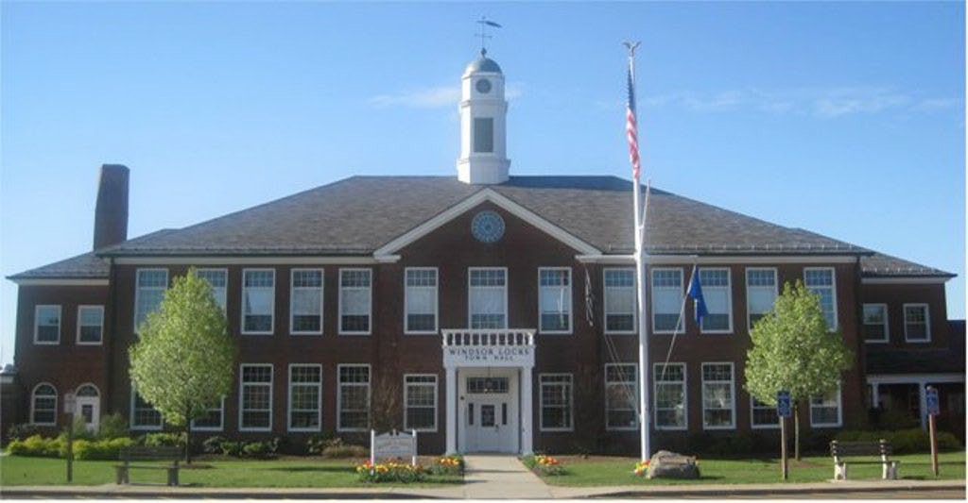
Board of Finance Adopted Budget FISCAL YEAR 2026-2027
April 28, 2026
1

Slide 2

Chair
Patty Murphy
Members Michael Ciarcia Daniel Flanagan Cornelius O’Leary Sean Twitchell Judy Chapman
Alternates Norman Weigert Roy Zettlemoyer
Finance Director
Yana Abramovich
2

Slide 3

Budget process begins late calendar year for Departments, Boards, and Commissions.
The Board of Finance starts hearing budget requests in February. The departments, boards and commissions are asked to provide realistic budgets needed to run their respective department or board.
The Board of Finance considers not only the expenditure requests for the budget, but also needs to make an estimate of expected revenues.
Cooperating with Boards and Commissions, the Board of Finance has worked diligently to develop a budget that provides needed services while trying to keep property tax bills at a reasonable level. We would like to thank the cooperative effort put forth by all the Boards and Commissions.
3

Slide 4

Use of Tax Stabilization Fund (TSF)
$201,630 decrease
Building Permits
$300,000 decrease
Tax Sale Collections/Prior Year Taxes and Fees
$500,000 decrease
Use of Bond Premium
$344,000 increase
Increase in October 1, 2025 Grand List due to economic development and 2 part of Property Revaluation Phase In

Slide 5

Proposed Mill Rate of 23.56 is a .43 mill decrease, or 1.8%.
Grand List increase of approximately $97.5 million . This number is after the effect of the phase in.
Total General Fund Operating Budget increase of 9.2%.
Use of $127,552 from General Fund Undesignated Fund Balance for one-time, long-term Capital Expenditures. Capital projects approved in Dec 25 used unallocated capital and interest on bonding funds.
No proposed funding for Roadway Infrastructure.

Slide 6

 | Adopted Budget 2025-2026 | BOF Approved Budget 2026-2027 | % Increase (Decrease)
Property Tax Collection | $41,866,461 | $48,490,809 | 15.8%
Other Tax Collections | 2,691,800 | 2,069,715 | (-23.11%)
Intergovernmental | 7,328,476 | 7,205,149 | (-1.7%)
Education | 4,652,368 | 4,652,368 | 0.00%
Charge For Services | 1,489,793 | 1,069,793 | (-28.19%)
Investment Income | 650,000 | 650,000 | 0.00%
Other Revenues | 127,000 | 127,000 | 0.00%
Other Financing | 2,066,420 | 2,208,445 | 6.9%
TOTAL | $60,872,318 | $66,473,279 | 9.2%

Slide 7
 | Adopted Budget 2025-2026 | Board of Finance Approved Budget 2026-2027 | % Increase (Decrease)
General Government | $2,598,179 | $3,233,741 | 24.45%
Public Safety | 6,439,402 | 7,253,592 | 12.64%
Public Works | 3,321,868 | 3,552,108 | 6.93%
Health & Welfare | 765,667 | 804,116 | 5.0%
Recreation | 760,478 | 822,578 | 8.16%
Employee Benefits | 8,348,190 | 9,377,267 | 12.33%
Debt Service | 4,467,616 | 5,335,619 | 19.43%
Board of Education | 34,051,186 | 36,094,257 | 5.99%
Capital Improvement | 119,732 | 0**
Total Budget | $60,872,318 | $66,473,279 | 9.2%
** LOCIP funds of 127,552 will be used for capital projects

Slide 8
 | Adopted Budget 2025-2026 * | Board of Finance Approved Budget 2026-2027 | % Increase (Decrease)
General Government | $2,791,199 | $3,233,741 | 15.85%
Public Safety | 6,582,536 | 7,253,592 | 10.19%
Public Works | 3,404,803 | 3,552,108 | 4.3%
Health & Welfare | 765,667 | 804,116 | 5.0%
Recreation | 760,478 | 822,578 | 8.16%
Employee Benefits | 8,348,190 | 9,377,267 | 12.33%
Debt Service | 4,467,616 | 5,335,619 | 19.43%
Board of Education | 34,051,186 | 36,094,257 | 5.99%
Capital Improvement | 119,732 | 0**
Total Budget | $61,291,407 | $66,473,279 | 8.45%
** LOCIP funds of 127,552 will be used for capital projects
*With TIF allocations

Slide 9
Taxable Grand List Comparison
2024 to 2025
 | 2024 Grand List | 2025 Grand List | $ Increase (Decrease) | % Increase (Decrease)
Real Estate | $1,577,370,484 | $1,571,396,990 | (-$5,973,494) | (.4%)
Personal Property | 260,224,317 | 334,757,782 | 74,533,465 | 28.64%
Motor Vehicle | 265,096,068 | 294,108,940 | 29,012,872 | 10.94%
Total Grand List | $2,102,690,869 | $2,200,263,712 | $97,572,843 | 4.64%
**With phase in, 2024 Real Estate was 1,300,047,915 or 20.87% increase to 2025

Slide 10
Increases Impact on Property Taxes
 | 2023 APPRAISED VALUE | 24 VALUE WITH PHASE IN EXEMPTION | 2025 APPRAISED VALUE
HOME VALUE 68% EST.INCREASE) | 178,000 | 238,000 | 300,000
ASSESSMENT | 0.7 | 0.7 | 0.7
ASSESSED VALUE | 124,600 | 166,600 | 210,000
 |  |  | ESTIMATED MILL RATES
MILL RATE | 0.02814 | 0.02399 |  | 0.02356 | 0.02399
ANNUAL TAX | 3,506 | 3,997 |  | 4,948 | 5,038
INCREASE |  | 490 |  | 951 | 1,041
PECENTAGE |  | 0.1399 |  | 0.238 | 0.261
MONTHLY CHANGE |  | $ 40.87 |  | $ 79.24 | 86.76

Slide 11
Average Increase by Assessment Range
MILL RATE | 25GL ASSMNT RANGE | # ALL | AVG TAX INCR | # OF RES | RES | # OF COMM | COMM
0.02356 | 0 - 50,000 | 104 | 5% | 53 | 6% | 51 | 4%
 | 51,000 - 100,000 | 87 | 27% | 75 | 29% | 12 | 15%
 | 101,000 - 150,000 | 467 | 21% | 446 | 21% | 21 | 9%
 | 151,000 - 200,000 | 1640 | 24% | 1625 | 24% | 15 | 11%
 | 201,000 - 250,000 | 1540 | 24% | 1523 | 24% | 17 | 7%
 | 251,000 - 300,000 | 649 | 24% | 629 | 24% | 20 | 12%
 | 301,000 - 350,000 | 270 | 24% | 250 | 26% | 20 | 1%
 | 351,000 - 400,000 | 117 | 23% | 103 | 26% | 14 | 2%
 | 401,000 - 450,000 | 44 | 21% | 35 | 25% | 9 | 3%
 | 451,000 - 500,000 | 8 | 30% | 3 | 72% | 5 | 4%
 | 501,000 - 550,000 | 8 | 12% | 2 | 18% | 6 | 9%
 | 551,000 - 600,000 | 8 | 4% | 0 | 0% | 8 | 4%
 | 601,000 + | 134 | 16% | 1 | 15% | 133 | 16%
 | TOTAL % |  | 255% |  | 310% |  | 97%
 | AVG INCREASE |  | 20% |  | 24% |  | 7%

Slide 12

FY 2026
Current Budget | Current Mill Rate
$60,872,318 | 23.99
FY 2027
Proposed Budget | Proposed Mill Rate
$66,473,279 | 23.56
Mill Rate Decrease : | (0.43)

Slide 13

Windsor Locks Public Schools
FY 27 Budget
Notes:
Shawn to speak

Slide 14

Windsor Locks Public Schools
FY 27 Budget
Overview of the FY27 Board of Education Budget
Explain key cost drivers and priorities
Outline steps taken to manage costs responsibly
Share the impact on students and programs
Notes:
Shawn to speak

Slide 15
Windsor Locks Public Schools
FY 27 Budget
Our Commitment
Provide high-quality education for all students
Maintain safe, supportive learning environments
Support academic, social and emotional growth
Be responsible stewards of public resources
Notes:
Shawn to speak

Slide 16
Windsor Locks Public Schools
2026-2027 Budget
Board of Finance Request(s) | Board of Education Budget Action(s)
Draft budgets of what is needed, separating needs from wants | 96% of FY27 budget is contractual obligations of needs Reviewed the historical budgeting challenges, deferred needs, therefore increasing costs each year compounded Reduced staff through attrition & review of enrollment trends - reduction of 11 teachers over last 3 years 4% of FY27 budget is controlled non-contractual spending Freeze on Superintendent salary increase in FY27 Reduction in professional development for Superintendent, Executive Director and other staff Reduced tuition reimbursement for Administrators Reduced supply lines based on historical funding Hiring cap on positions that are not in a shortage or high need area
Notes:
Shawn to speak

Slide 17
Windsor Locks Public Schools
2026-2027 Budget
Board of Finance Request(s) | Board of Education Budget Action(s)
Explore innovative cost savings | Exploration of ways to enhance student-centered coaching without adding staff and increasing budget Increasing enrollment into revenue generating programs (i.e. RISE, PMA, Open Choice) Reorganized technology replacement cycle through partnership with WLPS Strategic Planning Task Force Established a Strategic Planning Task Force to develop a 2026-2031 WLPS Strategic Plan that will drive future budgeting Deferred purchases in FY27 on specialized equipment and resources Reprioritized existing resources
Notes:
Shawn to speak

Slide 18
Windsor Locks Public Schools
2026-2027 Budget
Board of Finance Request(s) | Board of Education Budget Action(s)
Share meaningful improvements using residents tax dollars | Measurable growth in student reading outcomes; shifting to new assessment tool tied to Science of Reading State Accountability Index ranks WLPS #17 in all 36 Alliance Districts Added STEM programming at WLMS; pathway into WLHS Significant college acceptance successes Class of 2025 AP Recognition - College Culture - Silver; College Credit - Gold; AP Honor Roll - Silver! Staff and Administrators selected panelist at state level events highlight the work being done in the district
Notes:
Shawn to speak

Slide 19
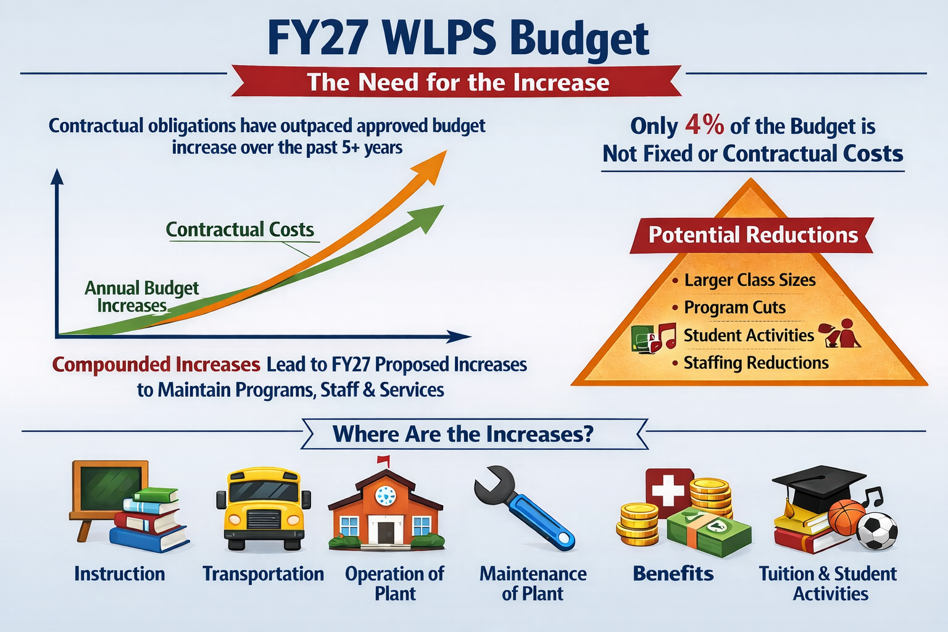

Slide 20
Windsor Locks Public Schools
2026-2027 Budget
The Breakdown of the FY27 Budget Total Increase
General Control (central administration, administrative expense) | $270,966
Instruction (school administrators, instructional staff, textbooks, and supplies) | $ 1,609,447
Nursing (nursing and healthcare needs) | $ (39,541)
Transportation (bus contract) | $ 123,420
Operation of Plant (building & grounds staff, contracted services, utilities, supplies) | $ 399,634
Maintenance of Plant (repairs, and replacement equipment) | $ (31,713)
Other (retirement, social security, insurance, student act., indoor air quality, tuition and special svs.) | $ 289,142
Medical Insurance Reinstated (previously BOF funded) | $2,500,000
Notes:
Shawn to speak

Slide 21
Windsor Locks Public Schools
The Board of Education FY27 budget stabilizes our district and….
Meet contractual obligations
Maintain student services
Protect long-term stability
Avoid deeper future reductions
Notes:
Shawn to speak

Slide 22
Windsor Locks Public Schools
FY26 Budget | FY27 Budget | $ Increase | 0% increase
$34,051,186 | $36,094,257.16 | $2,043,071.16 | 6%
  Board of Finance Adjustment - $2,500,000 (Medical Insurance)
Notes:
Shawn to speak

Slide 23
Capital Improvement Plan (Budget Flyer, Schedule D)
 | Funding Source
Designation | Unallocated Capital | Bonding
Board of Education | $ 14,500 | $ -
Public Safety | 38,052 | -
General Government | 75,000 | -
Library | - | -
Parks and Recreation | - | -
Public Works | - | -
Roadway Infrastructure | - | -
Total Capitals | $ 127,552 | $ -

Slide 24
Bonding Summary
$71.0 Million in outstanding debt (principal & interest as of 6/30/2026.
$5.6 Million of authorized and unissued debt as of 06/30/2026
This budget recommends no additional bonding projects.

Slide 25
Tax Increment Financing (TIF) Fund
The Town currently has 3 separate TIF districts:
  Downtown Main Street
  Champion’s Landing East
  Champion’s Landing West
The TIF districts create revenue by measuring incremental property value compared to a reference Grand List, before development starts.
The incremental taxes collected are received in the TIF fund, rather than the General Fund.
These revenues are used to further develop and benefit the district in which it was earned.
Currently, only the Main Street district is generating revenues and expenses.

Slide 26
Proposed TIF Fund Budget
Revenues:
 | Main Street Downtown | $489,171
 | Champion's Landing East | -
 | Champion's Landing West | -
 |  | $489,171
Expenditures:
 | Main Street Downtown | $489,171
 | Champion's Landing East | -
 | Champion's Landing West | -
 |  | $489,171
Estimated Revenues over Expenditures: |  | $0

Slide 27
What Happens Next?
Per section 804 of the Town Charter, the Annual Budget Meeting is held on the third Tuesday in May.
The Annual Budget Meeting has been set for Tuesday, May 19, 2026, at 7:30PM.
Q & A Sessions with the First Selectman & Board of Finance Chairman:
  Saturday, May 2nd 11AM – 1PM @ Town Hall
  Friday, May 8th 10AM – 12PM @ Senior Center
  Saturday May 15th 12PM – 2PM @ Town Hall

Slide 28
Board of Finance Adopted Budget FISCAL YEAR 2026-2027
April 28, 2026

