Slide 1


How to be an Effective Trustee
1-15-25
Daniel Foth, JD – Local government specialist,
Director – Certified Public Manager Program
University of Wisconsin – Madison
Local Government Education, Division of Extension
Acknowledgments: UW Madison – Division of Extension
Dan Hill: Retired Local Government Specialist
Larry Larmer: Retired Local Government Specialist
Philip Freeburg: Retired Distinguished Lecturer, Local Government Law Educator
Notes:
Good afternoon:
Thank you for participating in today’s virtual education on Procedures for Local Government Meetings, presented by the League of Wisconsin Municipalities, Local Government 101 Series.
My name is Daniel Foth, I am the interim Program Manager for the Local Government Education Program at he UW Madison, Division of Extension.
I am a retired attorney by trade and education and spent the bulk of my 40 year career in public infrastructure from highways, transit, airports, railroads and public/private utilities. What does that have to do with procedures for local government meetings, well we’re going to find out.

Slide 2
Getting Started
Name
Time on the Village of Black Creek Board
Employment and/or what keeps you busy
Notes:
Good Morning:
My name is Daniel Foth and I am a Local Government Specialist, with UW Madison Division of Extension. I am here today because Terri Ward and Amy Greil were working with Chairman Tom Roanhouse on ways Extension could assist this meeting.
The local government education program is part of a wide array of Extension Services. I encourage the Racine Village Board to work with Terri on understanding Extension’s services and benefit to Racine Village.
I’ve expressed to Chairman Roanhouse, that the Local Government Education program is available to assist Racine Village with any further training or other assistance.

Slide 3

What is the First Thing to Remember?
Know and

Slide 4
Board Function - Visionary
The Trustee role is that of “visionary.”
Trustee’s authority is collective versus individual
Legislate – to enact policy
  Holds staff accountable for policy implementation
  No operational control resides with individual Trustees
  Communications with staff – gathering information encouraged
  budgetary approval, monitoring, and
  cooperative decision making
Individual Trustee leadership role is within the board, committees, or commissions
Involve, represent & accountable to public
Focus on long-term rather than past or short-term
Cooperate with other governments
Notes:
Let’s transition from Village administration to the Village board of Trustees and its role.
As a member of the Village board, you serve in a legislative capaVillage. This differs from the commission form of Village government that you may hear about if you talk to colleagues from other states.
Village Trustees perform this legislative function through the adoption of resolutions and ordinances, plan adoption (strategic) and approving the annual budget. All of your work is done through a cooperative decision making process.
All of this means that no operational control over the Village rests with any individual Trustee. However, working cooperatively, Village boards oversee operations in terms of setting expectations or desired outcomes (strategic plan) and evaluating the progress in meeting those outcomes.
But ultimately it is Josh’s job to oversee the day to day operations of the Village and your job to set policy.

Slide 5
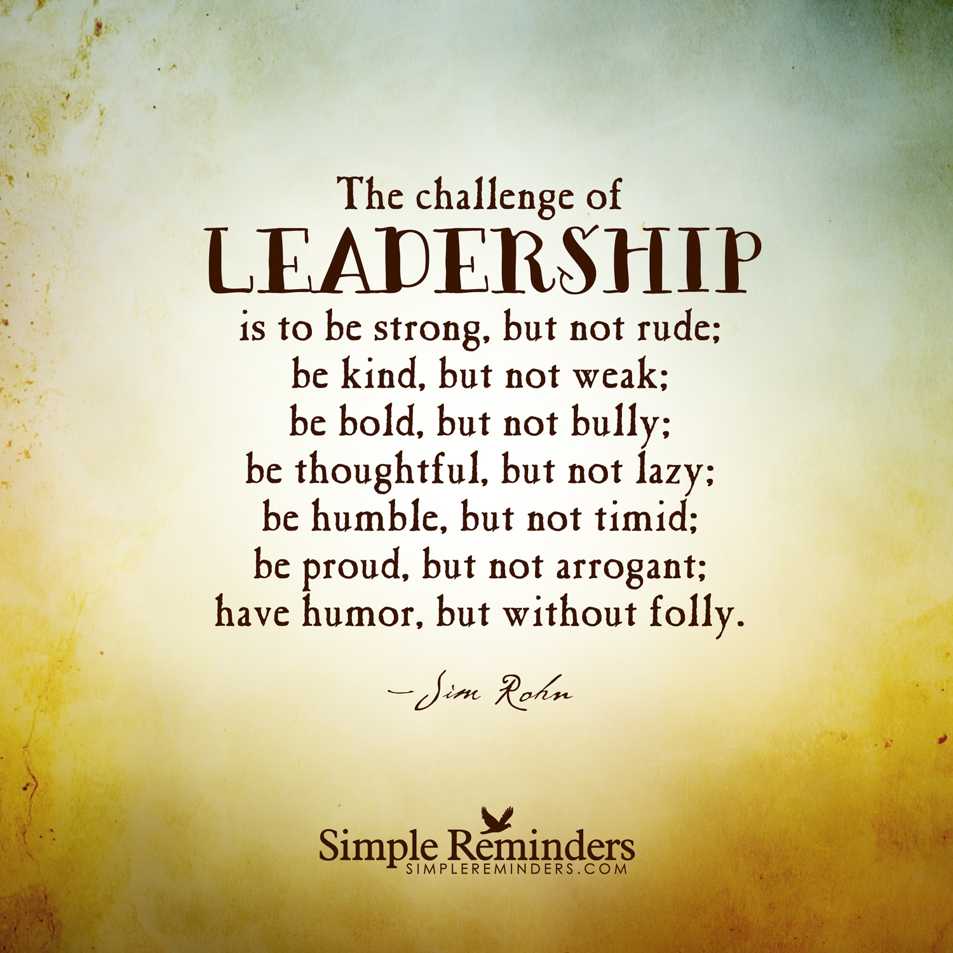
Leadership and Management
Collective Leadership – Village Board
  Inspire a Shared Vision
  Challenge the Process
  Enable Others to Act
  Encourage the Heart
Management – Staff/Committee Chairs
  Day-to-Day Operations

Slide 6

What Does It Mean to be a Visionary
A person thinking about or planning the future with imagination or wisdom.
A person with original ideas about what the future will or could be like.
Thinking beyond the present and asking yourself what the future could look like.
It is the foundation on which a leader builds a strategy for achieving the organization's desired future state.

Slide 7
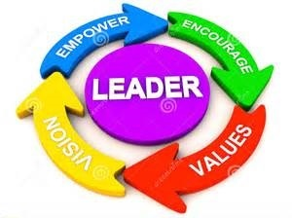
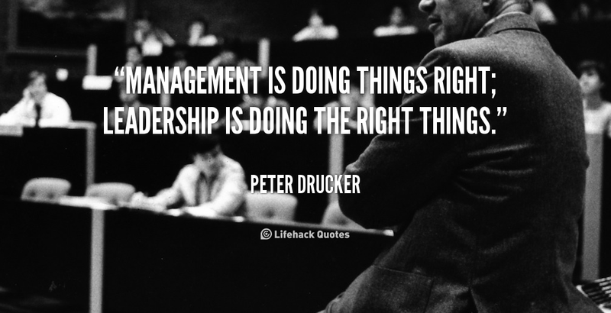
What is Leadership
“Good leaders have vision and inspire others to help them turn vision into reality.

Slide 8
Village President
(Wis. Stat. § 61.24 & § 89-5)
61.24 President.
A trustee and
Preside at all meetings of the board, and
Votes, and
sign all ordinances, rules, bylaws, regulations, commissions, licenses and permits adopted or authorized by the board and all orders drawn on the treasury, and
Maintain peace and good order, see that the ordinances are faithfully obeyed,
In case of disturbance, riot or other apparent necessity appoint as many special marshals as the president shall deem necessary, and
In charge of the village jail, and
Be an ex officio but nonvoting member of each committee (§ 89.5)
Designates Chair of each standing committee (§ 89.5 B)

Slide 9
Village Board (Wis. Stat. § 61.34 & Ordinance § 89-7)
Shall have the management and control of the Village property, finances, highways, streets, navigable waters and the public service, and shall have the power to act for the government and good order of the Village , and
Acquisition of property, easements, rights-of-way , and
Finances, and
Home rule to promote the general welfare, peace, good order and prosperity of the Village and its inhabitants.
Trustees primarily serve their legislative function through
  law-making
  budgetary approval
  cooperative decision-making
Trustee’s authority is collective versus individual

Slide 10
Standing Committees
Each has three Trustee members (§ 89-6 A)
(1) Finance Committee
(2) Building, Grounds and Equipment Committee
(3) Ordinance Committee
(4) Insurance and Personnel Committee
(5) Fire and Police Committee
Streets Committee
Water and Sewer Utilities Committee
Use committees to do the “work”
Board Meetings to approve/ratify the committee recommendations
Recognize committee work, or why have the committee?

Slide 11
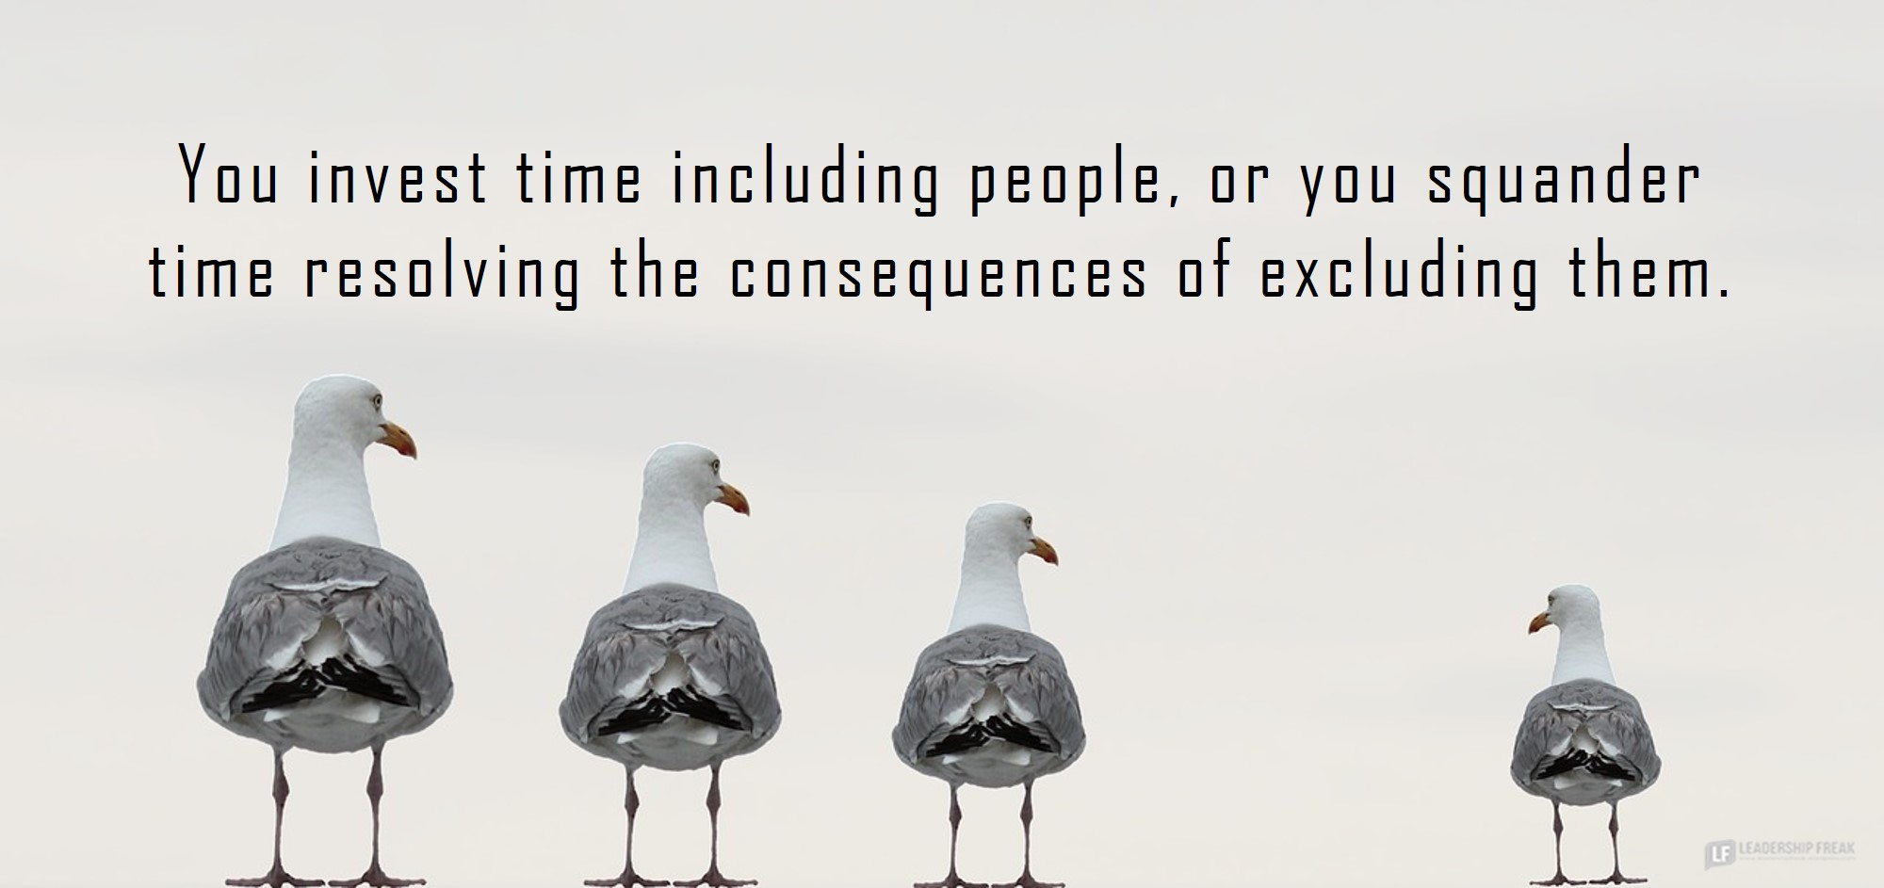
Policy versus Operations
Policy (Board) = “What” and “Why”
Operations (Staff) = “How” “When” and “Where”

Slide 12
Policy vs. Administration & Operations
Policy
  “What” – Will we fund new highway equipment?
  “Why” – Is it a necessary service to our citizens?
Operations
  “How” – How will we plow the roads?
  “When” – When will we start repairs?
  “Where” - Where will we fill potholes?

Slide 13
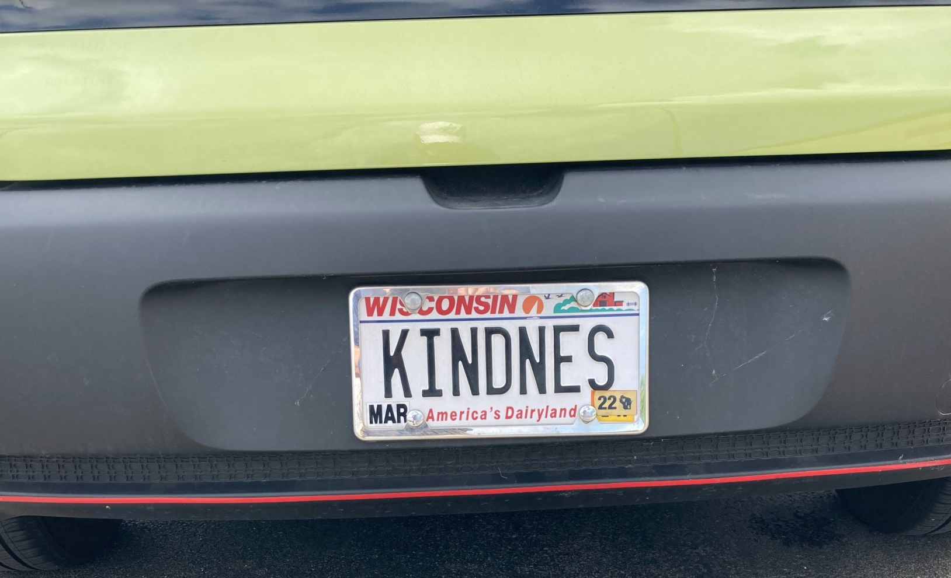
Policy - President & Board
Related to overall mission and purpose
Requires vision
Longer term
Addresses key issues
Strategy development

Slide 14
Operations (Committee Chairs and Department Staff)
Village Department Heads report to their respective Committee Chairs
Implementation of policies and strategies
Shorter term
Day-to-day operations
Related to smaller functions
Addresses department or individual issues
Requires attention to detail
Requires specialized training

Slide 15
Trustee / Staff Relations
What value does the staff bring?
How do you ensure focus is on policy implementation, not operational decisions?
How to get the most value from staff?
What are the ways to keep staff?
How important is the Village’s “reputation” as a great place to work?
What are you doing to build public trust in the Village, Board, and Staff?

Slide 16
Summary - Ends and Means
Policy making = Ends
Operations = Means

Slide 17
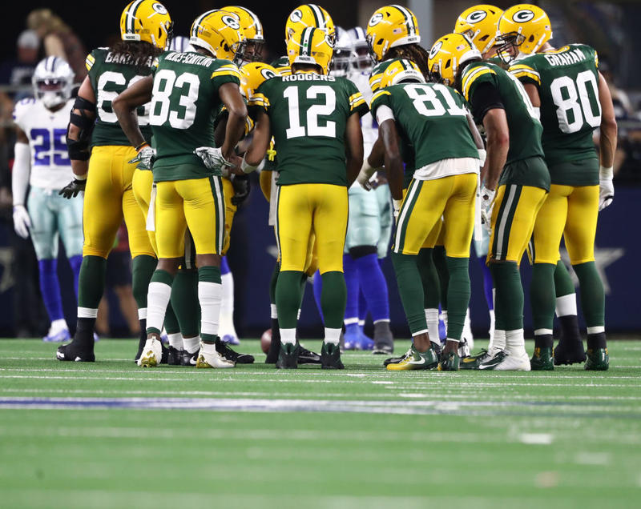
Summary - Ends and Means
Green Bay Packers have a Board of Directors
Board represents the shareholders
You do not see the Board Members on the sidelines calling plays
Nor are they in the huddle

Slide 18
Roles & Responsibilities Exercise
A Citizen calls to complain that their street has not been plowed. You should:
  Call the snow-plow operator and order them to plow the street immediately.
  Thank the Citizen and remind them that they did not vote for you, so sorry for their hard luck.
  Call the Public Works Director to discuss the issue so you understand what is going on in case you get more calls.
  Call the President and demand action to rectify the issue.
  Have another cup of coffee and do nothing.

Slide 19
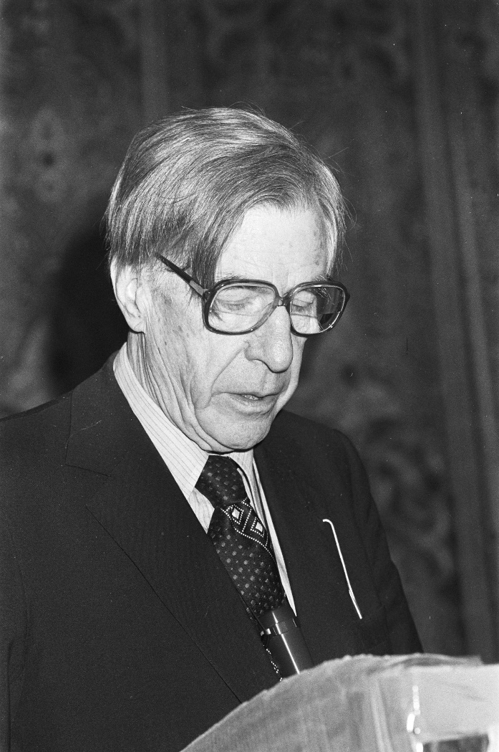
Meetings
“Meetings are indispensable when you don’t want to do anything.”
- John Kenneth Galbraith
Notes:
File:Top Management Forum in Hilton Hotel in Amsterdam. Gastspreker professor John K. Galbraith, Bestanddeelnr 931-9939.jpg - Wikimedia Commons

Slide 20

President or Chair - Meetings
Chair is responsible for the agenda
  Members may place items on the agenda (more on this later)
Clerk prepares the Agenda
Chair has all the rights of participation, including making and seconding motions and voting
Chair is responsible for administering the group’s deliberations
Notes:
Chair is responsible for administering the group’s deliberations
An effective meeting starts with the Chair
The Chair starts and keeps the meeting going through the agenda items.
The Chair may participate, but should step down if participating in an item discussion.
foster orderly discussion
Announces issues and keeps members on track
Restates motions for clarity
Recognizes members
Seeks balance

Slide 21
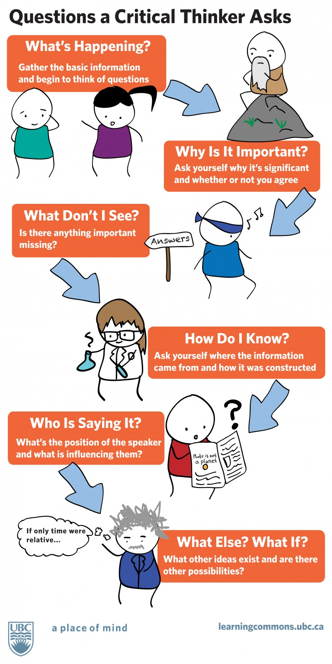
Trustees
Prepares for the Meeting
Attends the Meeting (on time!)
Contribute as appropriate.
Respects other opinions and comments
No sidebar discussions - address comments to presiding officer
Focus on THIS topic—not last week’s vote
Listen to understand
Vote
Mute and stay off personal electronic devices
This Photo by Unknown Author is licensed under CC BY\

Slide 22
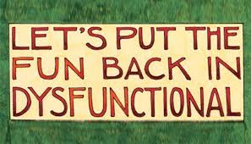
Agendas
Purpose of the Agenda
  Sets the expectations for the members of the governmental body and the public.
    Items of business that will be addressed.
    The order in which they will be considered.
  Conforms with the Wisconsin Open Meetings Law

Slide 23
Who Sets the Agenda?
The Chair/Clerk work together to develop the agenda and publish the meeting notice.
Order of Business per Ordinance § 89-16
Any Trustee can, in writing, ask the Clerk to place an item on the Agenda § 89-17
A Trustee can always make a motion at a meeting to add an Agenda item to the next meeting’s Agenda.
(Ordinances, RONR, as modified by WI open meetings law)

Slide 24
Minutes (Wis. Stat. § 985.01(6) & § 89-11 A)
The official record of the proceedings of the governing body.
  Accurate record that a meeting was held.
  Captures the substance of the official action taken by the body.
    “Substance”—an intelligible abstract or synopsis of the essential elements of the official action taken by a local governing body, including the subject matter of a motion, the persons making and seconding the motion, and the roll call vote on the motion. Record motions, seconds, and any action taken
Not a blow-by-blow account
Published at least three hours prior to the meeting

Slide 25
Minutes – Core Concept
Minutes should focus on what the body did, not on what was said. That is what was
  Announced
  Reported
  Discussed
  Ordered
  Commitments made
  Decisions made

Slide 26
Recording Formal Decisions
Exact wording of all motions - As a recorder, ensure you get the wording down before the vote is taken.
Must record person making and seconding (Wis. Stat. Sec. § 985.01(6))
If a decision is made by unanimous consent, the minutes should reflect it.
Show the distribution of counted votes (“Motion carried, 5-2”).
Roll call vote – indicate how each person voted.
Voice vote – indicate outcome and that voice vote was taken (Motion carried, voice vote)

Slide 27
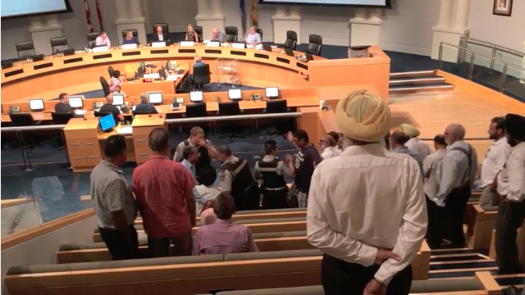
What is a Meeting?
Meeting is a gathering of members of a governmental body for purposes of exercising its responsibilities
(Wis. Stat. Sec. 19.82(2))
Village has Regular Meetings and Special Meetings
(§ 89-11)
Notes:
Wis Stats 19.82(2) describes a “meeting” It’s a little bit like the IRS definition of income “From whatever source derived.” That is, it is a broadly defined and understood definition.
As we will see shortly, exercising its responsibilities includes “discussion, information gathering or decision-making on a matter within the jurisdiction of the body”

Slide 28

Intent of Open Meetings Law
Ensure:
Public Access
Open Decision-Making: information gathering, discussion, and voting
Through:
  Advance public notice of meetings,
  Meetings that are open and accessible to the public
  Limited closed sessions.

Slide 29
What bodies are subject to the WI Open Meetings law?
  local governing bodies of general and special purpose units of government,
  their committees, commissions and boards,
  special study and advisory committees, and other bodies or subunits created by a governmental body or an officer, and
  governmental and quasi-governmental corporations.
    (Body members covered by the law include citizen members.)
(89-13 and § 12-6)-
Notes:
Virtually any body created by the parent body.

Slide 30
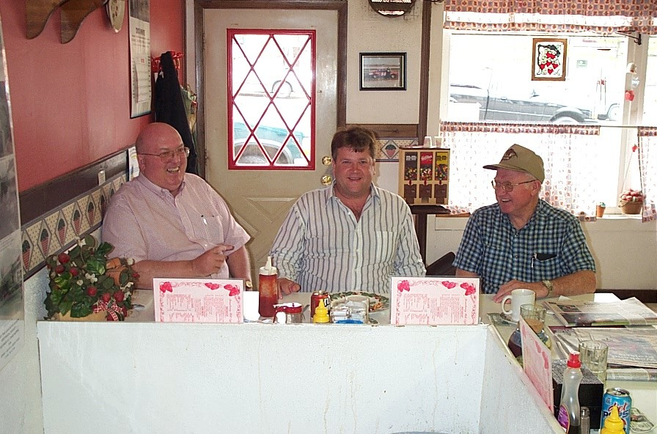
Meeting defined - The Two Tests
Numbers test = enough members of a body are present to determine the outcome of an action
Purpose test = discussion, information gathering or decision-making on a matter within the jurisdiction of the body.

Slide 31

Numbers Test
  By statute, if one-half of the members of a body are present, there is a presumption that a meeting has occurred, unless the purpose test is not met.
  A lesser number of members may meet the numbers test if they can affect the outcome.
<

Slide 32
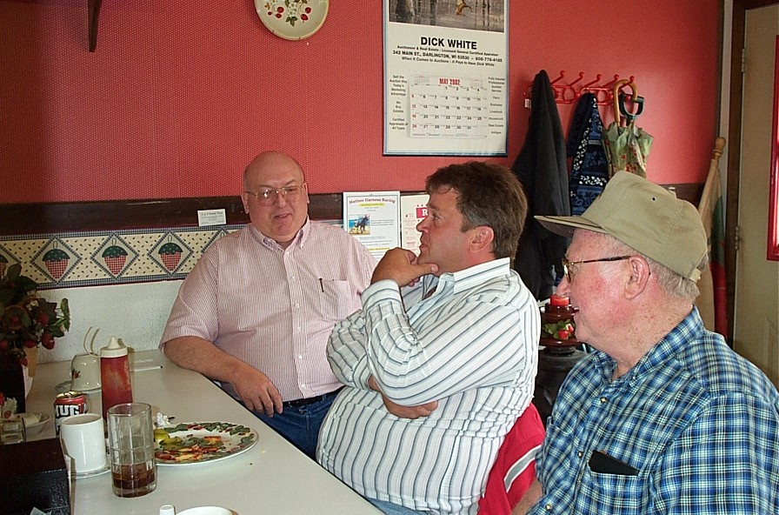
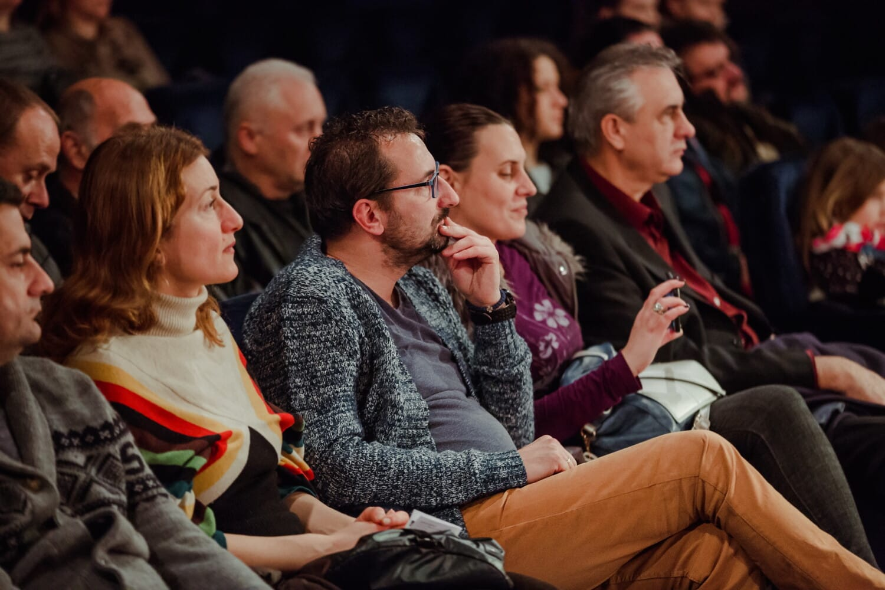

Quiz Question
Is there an open meetings law violation?
A
B
C

Slide 33
Responses
Yes - Picture A
Yes - Picture B
Yes - Picture C
Yes - All Pictures
None
Need more information

Slide 34
Quorum
Four (majority) of the Board’s members constitute a quorum. (Wis. Stat. § 61.32 & § 89-14)
A quorum must be present to conduct business.
If a meeting is noticed and convenes with fewer members than a quorum, consider adjourning and rescheduling until a future meeting when a quorum is present.
  See Board of Supervisors of Oconto County v. Hall, 47 Wis. 208, 213 (1879) (stating the general rule that any action taken by a governmental body at a meeting without a quorum is null and void).

Slide 35
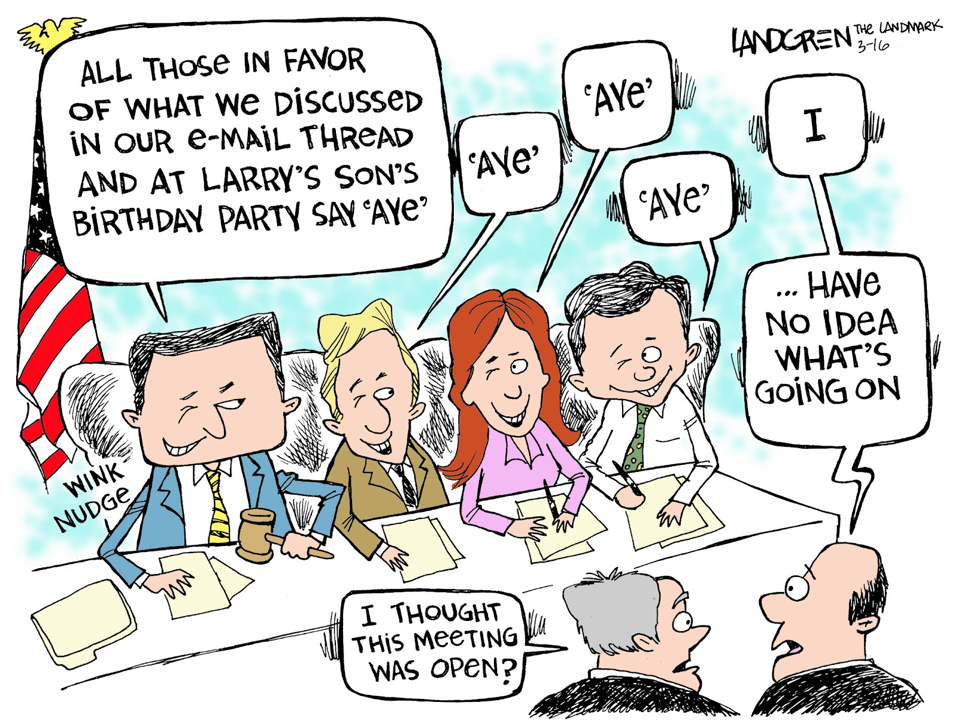
Some Special Cases
Walking Quorum--A series of phone calls, e-mails or conversations to “line up votes,” gather information or conduct other business
Emails, Texts, Social Media posts, and phone conferences may constitute a meeting if the number and purpose tests are met.
Notes:
Phone conferences may constitute a meeting if the numbers and purpose tests are met. A sequence of phone calls to “line up votes” or conduct other business constitutes an illegal meeting since it is not noticed and open to the public.
Chance and social gatherings and conferences where the numbers test is met are not meetings provided the purpose test is not met (i.e. no board business is discussed).
A walking quorum, violates the law since the public is not notified of a meeting & the meeting is not open.

Slide 36
Walking Quorum - Elements
A series of gatherings among body members that are each smaller in size than a quorum.
Where an agreement to act uniformly is implied or expressly reached.
In sufficient number to control the body. If a body engages in governmental business over a series of smaller meetings and reaches a consensus, they have violated the OML.
Even though each individual meeting might not amount to a “meeting” legally speaking, the cumulative effect is that a “meeting occurred” in violation of OML.
In State ex rel. Zecchino v. Dane Cty. Bd. of Supervisors, 2018 WI App 19, the Wisconsin Court of Appeals held that a county supervisor individually emailing less than a negative quorum of county board members to track votes on an issue did not amount to a prohibited walking quorum.
However, if the county supervisor in State ex rel. Zecchino had individually polled a quorum of board members, it likely would have amounted to a walking quorum. See DoJ

Slide 37
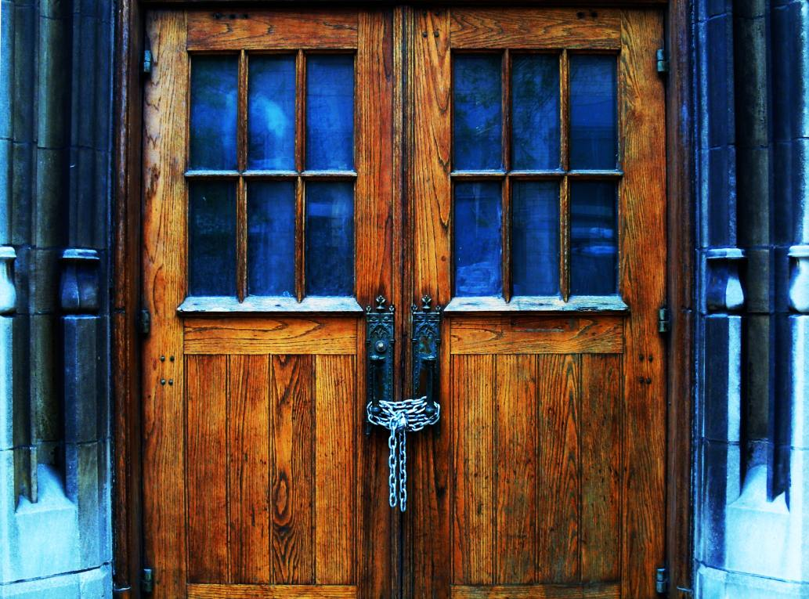
Permitted closed sessions
Closed sessions are limited to those authorized by statute, including...
  Deliberations concerning a judicial or quasi–judicial “case”.
  Personnel matters including employee discipline and licensing.
  Deliberations on property acquisitions, investments.
  Competitive or bargaining issues.
This Photo by Unknown Author is licensed under CC BY-NC

Slide 38
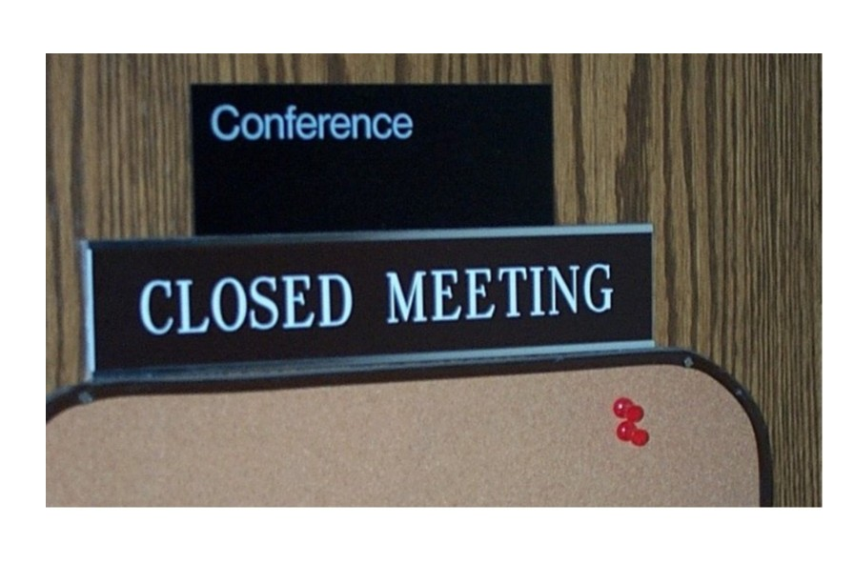
Closed session procedures
Convene in open session.
Announce authority and purpose of proposed closed session.
Close session by a majority vote, showing vote of each member.
If unanimous, note as such

Slide 39
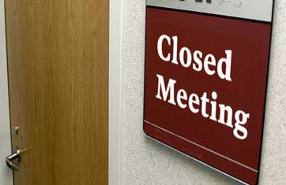
Closed session procedures
All governing body members (includes any who objected. Also, any Personnel essential to closed meeting discussion)
If a committee, then members of parent body may remain.
Limit discussion to announced items.
Do not reconvene in open session unless it was included in the public notice.
Notes:
Members of the parent body may not be excluded, unless the parent body has its own rules to the contrary.

Slide 40
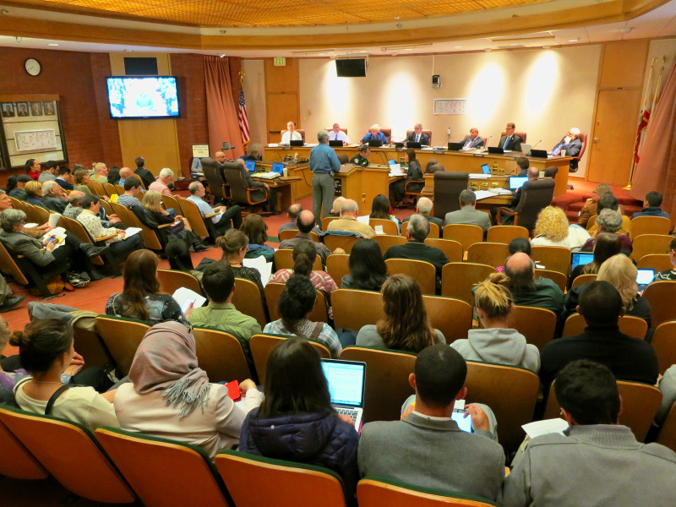
The Audience & Citizens – The Community
CITIZENS’ RIGHT TO ADDRESS
THE Board
No right unless given by the President or Chair
(§ 89-19 C(3)).
The body hears comment(s)
  The chair may provide limited answers to public questions, but no debate, and no action may be taken.
  May ask for clarifying comments
  Take no action, except to place on a future Agenda if needed
Suggest a Public Comment Policy
Comments must pertain to agenda items
Three-minute time limit per person
Maintain decorum

Slide 41
Open Meetings Exercise
Walking Quorum
You are a member of a committee of five people. You post a request on your Trustee Facebook site for community input on an upcoming committee meeting agenda item. Two other Trustees, also on the committee, respond.
Is this an open meeting violation?
What happens if you happen to see the other two Trustees on the street and stop to discuss?

Slide 42
Closed Meetings Exercise
Closed Meetings
At a Committee meeting, you realize that an Agenda Item is better dealt with in a closed session, because it fits one of the statutory definitions to close a meeting.
  Can you make a motion to close the meeting?
No – a closed meeting must already be on the Agenda. However, the committee member can move to postpone the discussion to the next meeting.

Slide 43

Meeting Procedures & Rules
Facilitate a decision made by the majority
Providing the ability to hear all views.
Provide an orderly way to disagree without being disagreeable
Sets expectations for the meeting process and conduct
Sources of Meeting Rules
  State statutes and Constitution
  Local Government Meeting Rules
  Rules of Order
(Wi Statues, § 89.15 C, Roberts Rules of Order Newly Revised (RONR))
Notes:
Other Rules of Order (11 books that I know of)
Thomas Jefferson’s Manual of Parliamentary Practice
Erskine May's Treatise on the Law, Privileges, Proceedings, and Usage of Parliament
Welty’s Book of Procedures
The Modern Rules of Order
Fundamental’s of Parliamentary Law and Procedure
Saint John Senate Rules of Order and Procedure
Bourinot’s Rules of Order
Bosner Method
Green Party of Canada variation of Bosner Method
Talking Stick
Good ol Consensus

Slide 44
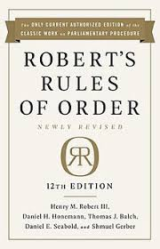
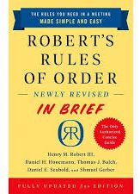
Roberts Rules of Order
Facilitate Discussion, Not Obstruct It
  Justice and courtesy to all
  Each proposition is entitled to full and free debate discussion
  Address only one issue at a time
  Common understanding
  Substance over process
Fairness to All
  Majority
  Respect the rights of the minority & individual Members
Provide Order
  The majority rules
  Decorum
Notes:
What is key about RONR is that its purpose is to facilitate discussion and fairness.
Brand New Updated Versions of Robert’s
12th Edition
In Brief - 3rd Edition
By the way, if the Standard Robert’s Rules of Order book is difficult for you to use, try this version. Published by the Robert’s organization, it is a much easier read and it also references back the main Robert’s Rules manual

Slide 45

Why Meeting Rules & Procedures?
Clear communication through clear motions
Meeting Decorum – Board meeting discussion conduct
Meeting agenda approach
Separate decision and discussion items.
Actions violating local meeting rules

Slide 46
Village Meeting Rules
§ 89.15 C RONR applies & Point of Order & Objection
§ 89-16 – Order of Business
§ 89-17 – Introduction of business
§ 89-19 – Deliberations
§ 89-20 – Reconsideration of Questions
§ 89-21 – Disturbances
§ 89-22 – Amendment of Rules
§ 89-23 – Suspension of rules

Slide 47

Meeting Dynamics
What is the meeting purpose?
Does everyone understand that purpose?
Not all approach meetings the same way
Our personalities can influence our interactions
Knowledge helps accommodate people to be fully engaged
Meeting Definition
A meeting is a deliberation where hours are wasted, and minutes are recorded
Notes:
To avoid your meeting turning into chaos, lets first talk about some Meeting Dynamics to keep in mind as you prepare to run your meeting
What is and does everyone understand the meeting purpose?
Remember, everyone comes to the table with a different perspective and most importantly our personalities can influence these interactions
So next meeting, before commenting on an item, think about this information and the personalities and bias you and others may bring to a meeting
Type “As”, I know this is warm/fuzzy stuff, but stay with me here

Slide 48
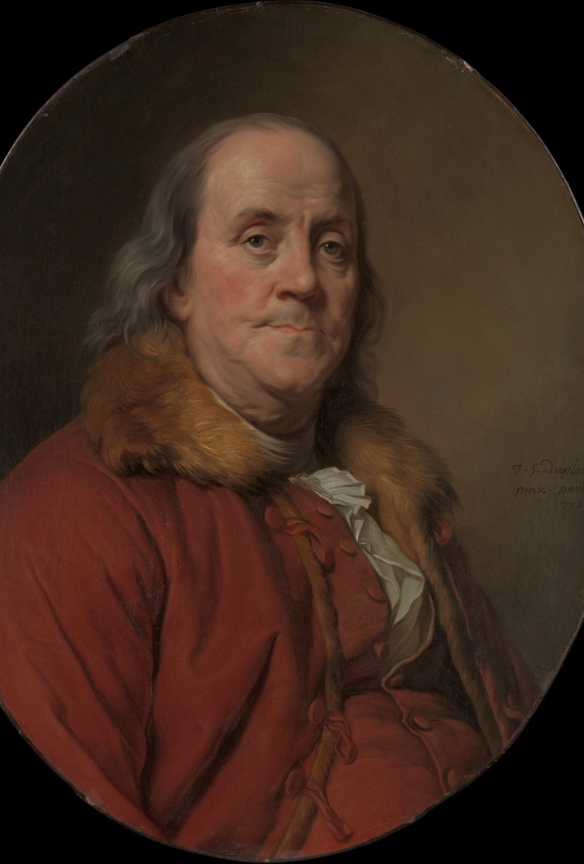
Before the meeting
“By failing to prepare, you are preparing to fail.”
- Benjamin Franklin
Notes:
File:Benjamin Franklin (1706–1790) MET DP312881.jpg - Wikimedia Commons

Slide 49

Meeting Preparation
  Review agenda & materials before the meeting – do your homework!
  Do you have the information you need to make a decision? If not, ask the President, clerk or staff before the meeting.
This Photo by Unknown Author is licensed under CC BY-SA

Slide 50


Decorum Rules For Elected Officials & Meeting Participants
Stay on the Agenda
Confine remarks to the pending issue
Stay on Topic – Do not speak to an action not pending
Refrain from speaking against your own motion
Avoid (no) “negative” motions
Refrain from actions that “disturb the assembly.”
Respect – Golden Rule as a guiding principle
(RONR)
Notes:
Some discussion decorum rules I find helpful and pass them on to you for your consideration.

Slide 51

Interpersonal Dynamics

Slide 52
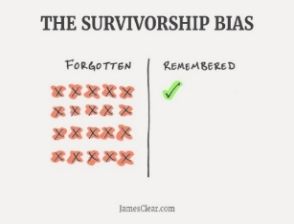


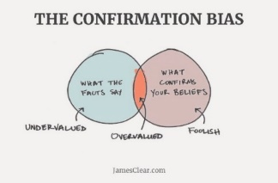
Bias - Common Mental Errors That Prevent Making Good Decisions
Survivorship Bias
Loss Aversion
The Availability Heuristic
Confirmation Bias
Adapted from James Clear, https://jamesclear.com Copyright © 2018
This Photo by Unknown Author is licensed under CC BY
Notes:
Bias, everyone has them, lets talk about some of the common Bias
I receive a weekly email update from James Clear whose website has a lot of personal development information that I find very useful I recommend you check out his website
Survivorship Bias
Loss Aversion
The Availability Heuristic
Confirmation Bias

Slide 53
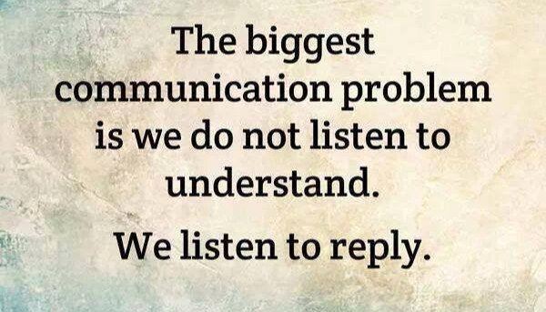
Communication Starts with Listening
The single biggest problem with communication is the illusion that it has taken place.
Attributed to George Bernard Shaw
Notes:
I first started using this approach when I was a Project Manager for a number of large eclectic transportation and planning projects. All of them involved significant community involvement and engagement sessions.
For each session, we always started with a Listening to Understand slide to help the session participants to listen to others to understand, not to reply.
I recently read another approach that I like too: Shut Up and Listen

Slide 54
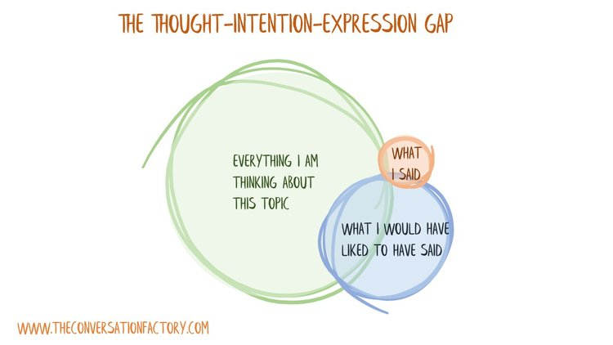
Thinking versus Speaking
What I meant to say
What I said
Everything I am thinking about this topic - The basic constraint is:
  People can think at up to 4,000 words a minute
  We can only speak at 125 words per minute, in most cases.
    There will always be more to say than we can ever express.
    There is more that we are thinking about a topic than we might even hope to say
So, choose your words carefully
The Talking and Thinking Gap
https://www.danielstillman.com/blog/the-thought-intention-expression-gap

Slide 55

Listening - with your Eyes, Ears, and Feelings
Active listening
  Pay attention. Give the speaker your undivided attention and acknowledge the message.
  Show that you are listening.
  Provide feedback.
  Defer judgment.
  Respond Appropriately.
Listen to what the other person is saying – not your assumptions
Body language
Pay attention to your feelings
This Photo by Unknown Author is licensed under CC BY-NC-ND

Slide 56
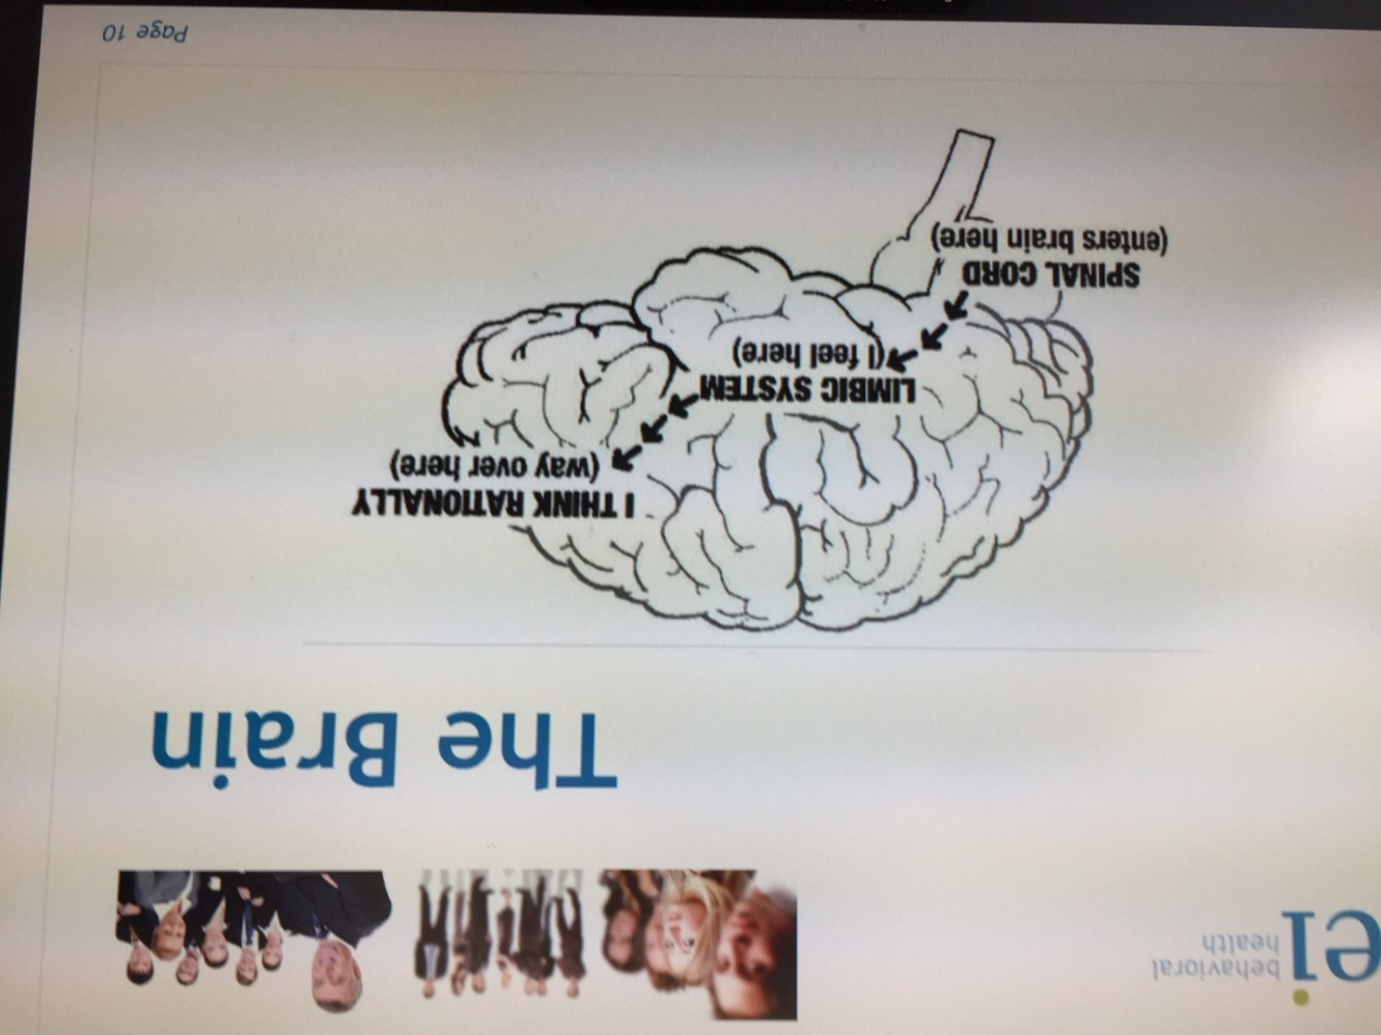
And “hears” why!
Cerebral Cortex
Notes:
The graphic also helps to understand why we typically react first, then think.
The cerebral cortex of the brain is responsible for higher thought processes, and the left hemisphere is the rational half associated with logical and analytical thinking. It consists of gray matter arranged in folds that cover the cerebrum and is located in the front part of the brain.

Slide 57
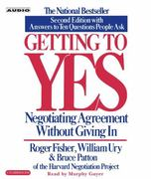
Positions vs. Interests
Positions vs. Interests – Fisher, Ury & Patton
Positions – what each party wants
I do not want the Village adopt a zoning ordinance
Interests – the reasons why the individual has taken the position
I want to be able to do what I want with my land
Notes:
Negotiations Article: Positions and Interests in Negotiations (bakercommunications.com)
https://www.pon.harvard.edu/daily/negotiation-skills-daily/principled-negotiation-focus-interests-create-value/

Slide 58
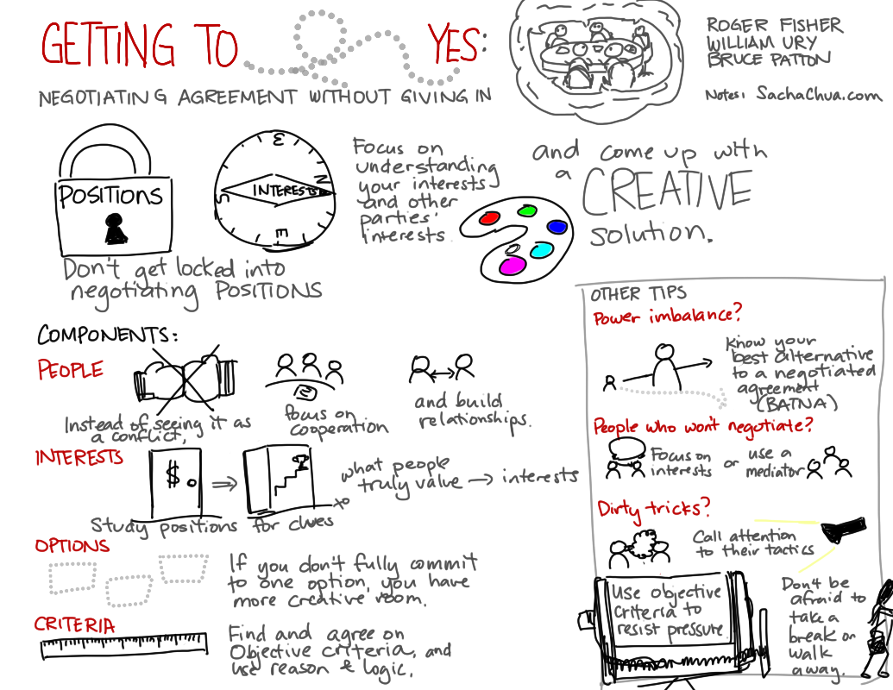
Getting to Yes
Getting to Yes, by Roger Fisher, William Ury & Bruce Patton
Notes:
Separate People from the problem
Understand the Interest behind the position
Ask (clarifying questions): Why is that? What do you hope for? What would be wrong with…? Are you afraid something will happen?
Solicit their advice, “what would you do?” to start the conversation
Consider starting with a joint exploration of interests
Dig for the interests that lie behind the demands
Seek options

Slide 59
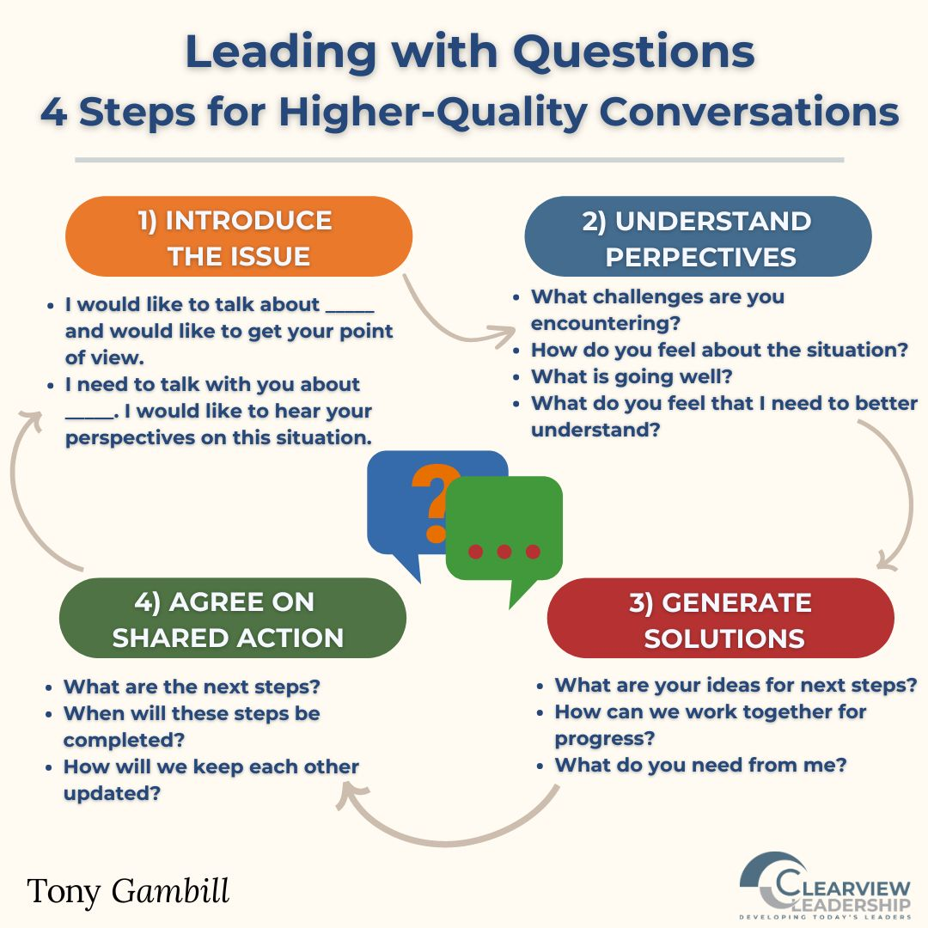

Slide 60
Scout Mindset
Soldier Mindset | Scout Mindset
Reasoning is like defensive Combat | Reasoning is like map making
Decide what to believe by asking either ”Can I believe this” or “Must I believe this” depending on your motives | Decide what to believe by asking “Is this true”
Finding out your wrong means suffering a defeat | Finding our you’re wrong means revision your map
Seek our evidence to fortify and defend your beliefs | Seek out evidence that will make your map more accurate
Related concepts: Directional motivated reasoning, rationalizing, denial, self-deception, and wishful thinking | Related concepts: Curiosity, Accuracy, motivated reasoning, truth-seeking, discovery, objectivity, and intellectual honesty
The Scout Mindset, by Julia Galef, 2021

Slide 61

What is a Motion?
A Motion is a formal proposal by a member of the body, in a meeting, that the body take certain action.
(RONR)
Notes:
Now we will move to Motions – what is a motion, how is it made and how a Motion moves forward.

Slide 62
Motions
Required on substantive issues
Avoid negative motions, accepting informational reports, reaffirming existing policy
Should be stated fully and repeated by chairperson, once seconded
Must be seconded, unless incidental
Notes:
Negative motion – Lets not send the President to the Roberts rules training. What happens if the motion passes? What happens if the motion does not pass, does that mean the President gets to go to the meeting?

Slide 63

Motions
Main Motion - Starts the discussion
  Only one MAIN motion can be pending at any given time
Other classes of motions take precedence over main motions
  Privileged Motion - Relates to the meeting itself
  Subsidiary Motions - Relates to the treatment of main motion
  Incidental Motions - Relates to the conduct of the meeting
Notes:
Only one main motion can be pending at a time
Under the Robert system, motions that are actions of the body such as ordinances, resolutions, and actions of lesser scope such as purchases, are regarded as main motions. To keep the body’s proceedings clear and orderly, only one main motion can be pending at a time. A main motion that is offered while another one is pending is out of order.
(NOTE: “Pending” means that a motion has been moved, seconded, and stated by the chair and is now owned by the body and is the primary focus of the body’s attention.)
(NOTE: It will be useful to refer to the chart “Basic Information on Motions” as the next bullet is discussed.)
Other classes of motions take precedence over main motions
And what does Precedence mean?
It means it goes first, while the main motion is pending and can be discussed or dealt with
Robert, as well as other parliamentary systems, recognizes classes of motions other than main motions.
Motions that affect the treatment or substance of main motions are called “subsidiary motions” and can be made while a main motion is pending. If a subsidiary motion is relevant and otherwise in order, it will, upon being moved, seconded, and stated by the chair, replace the main motion as the focus of the body’s attention and is said to be “immediately pending.” If a subsidiary motion is passed the main motion is affected by whatever action the subsidiary motion proposed. If a subsidiary motion fails, the body’s attention returns immediately to the pending main motion. The chart indicates a ranking among subsidiary motions. Those appearing above the others on the chart take precedence over those listed below.
Thus, for example, it is in order to move to refer a pending main motion and a pending amendment to the main motion to a committee. When the motion to refer is made, seconded and stated by the chair, it becomes immediately pending. If the motion to refer is adopted, the main motion and the amendment are sent to the committee to be treated in accordance with instructions contained in the motion to commit or in accordance with the customary practices of the local government body. If the motion to commit fails, the body’s attention returns to the motion to amend.
Motions that are more concerned with event of the meeting – for example, whether members can participate without distraction, whether or not to recess, whether the body is attending to the business it should be at a particular time, or whether to adjourn – are called “privileged motions.” Any of the privileged motions can be made while a main motion or any of the subsidiary motions is pending. Like subsidiary motions, privileged motions have a rank among themselves. Thus, a privileged motion above any other privileged motion can be made while the lower ranking motion is pending.
Some motions, requests, inquiries and points or order, called “incidental motions,” are situation specific and, if relevant to the situation at hand, are in order when motions of other classes are pending and will take precedence over those pending motions.

Slide 64
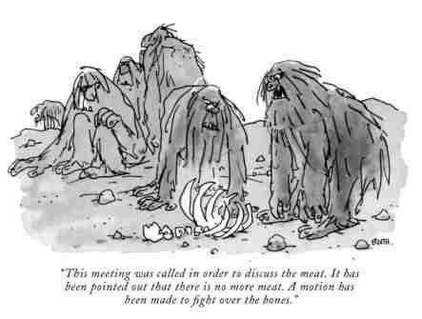
Main Motion
Main Motion - Starts the discussion process
  I move that “____________”
(RONR)
Notes:
A main motion gets the process moving

Slide 65
Incidental Motions
Incidental Motions - Relates to the conduct of the meeting
  Division of a Question – chair responds
  Point of Order – chair responds
  Withdraw a Motion – majority vote
  Appeal a Decision of the Chair - Member motion & second
  Suspend the rules
  Split a Main Motion containing two or more separate parts.
  Decide amendments to complex main motions in separate parts
Notes:
Incidental motions relate, in different ways, to the pending business or to business otherwise at hand.
Appeal - Although the duty of ruling on all questions of parliamentary procedure affecting the assembly's proceedings rests with the chair, any two members, by moving and seconding
If an original main motion* has been made and a member believes that it would do harm for the motion even to be discussed in the meeting, he or she can raise an Objection to the Consideration of a Question – Whoa, wait just a dog gone minute buster – didn’t you just say this was a Subsidiary Motion?
So that’s why it’s a good idea not to get too wound up in defining the type of motion

Slide 66
Privileged Motions
Privileged Motion - Relates to the meeting itself
  Raise a Question of Privilege – chair responds
  Call for orders
    Stick to the Agenda
  Pressing issue
    Raise a question of Privilege
  Recess
    specified length of time
  Fix a time to adjourn
    Adjourn – majority vote
Notes:
All of these call for a Majority Vote –
Questions of Privilege are special situations that require:
Member to raise then state the Question
Raising question does not require a second
Does the question apply to the Assembly or the person
The Chair then:
decide if it is in fact a Question of Privilege
Chair’s decision is final, no appeal or reconsideration
Chair decides if the question requires formal Assembly action he can move, or ask the Member to move, then that motion requires a second
Recess requires a motion and second and is not debatable

Slide 67
Subsidiary Motions
Subsidiary Motions - Relates to the treatment of main motions
  Lay on the Table (table motion) – majority vote
  Previous Question (close discussion) – two-thirds vote
  Amend – majority vote
  Postpone - majority
  Refer to Committee - majority
  Extend Debate – two-thirds vote
Notes:
If an embarrassing main motion* has been made and a member can propose to get rid of this question without bringing it to a vote by moving to Postpone Indefinitely
Lay on the Table – much confusion – remember the US Senate has its own rules. Originally, used for more pressing business that needed attention. Now used to postpone indefinitely

Slide 68
Q#5 – Which of these main motion statements are true?
The Main motion starts the discussion
Only one Main motion can be pending at any given time.
The Main motion relates to the meeting itself.
The Main motion takes precedence over all other motions.
Privileged, Subsidiary, and Incidental motions take precedence over the Main motions.

Slide 69
Q#5 – Which of these main motion statements are true?
The Main motion starts the discussion
Only one Main motion can be pending at any given time.
The Main motion relates to the meeting itself.
The Main motion takes precedence over all other motions.
Privileged, Subsidiary, and Incidental motions take precedence over the Main motions.

Slide 70
Robert 's Rules of Order Motions Chart
- https://robertsrules.org/motions.htm
Part 1 - Main Motions. These motions are listed in order of precedence. A motion can be introduced if it is higher on the chart than the pending motion.
RONR § | Purpose | You Say: | Interrupt | 2nd | Debate? | Amend? | Vote?
§21 | Close meeting | I move to adjourn | No | Yes | No | No | Majority
§20 | Take a break | I move to recess ... | No | Yes | No | Yes | Majority
§19 | Register complaint | I rise to ask a question of privilege | Yes | No | No | No | None
§18 | Make follow agenda | I call for the orders of the day | Yes | No | No | No | None
§17 | Lay aside temporarily | I move to lay the question on the table | No | Yes | No | No | Majority
§16 | Close debate (discussion) | I move the previous question … | No | Yes | No | No | 2/3rd
§15 | limit or extend debate (discussion) | I move that discussion be limited to … | No | Yes | No | Yes | 2/3rd
§14 | Postpone to a certain time | I move to postpone the motion to … | No | Yes | Yes | Yes | Majority
§13 | Refer to committee | I move to refer the motion to ... | No | Yes | Yes | Yes | Majority
§12 | Modify wording of motion | I move to amend the motion by … | No | Yes | Yes | Yes | Majority
§11 | Kill main motion | I move that the motion be postponed indefinitely … | No | Yes | Yes | No | Majority
§10 | Bring business before assembly (a main motion) | I move that (to) … | No | Yes | Yes | Yes | Majority
Notes:
The Order of Precedence is an important part of the Robert’s (and Other) rules of parliamentary procedure. To help you understand how this works:
Member A (governing body member or committee member) makes a main motion, I move to buy a new computer for the Clerk - & a second
Member C thinks that the entire Village staff needs a new computer and moves to amend the motion. and a Second
Member B has a chicken dinner waiting and moves to limit discussion to 10 minutes
Member D is now getting hungry and wants a 10 minute recess to eat a candy bar, but cleverly disguises the intent by noting a need for a restroom break
What does the chair do? Using the Order of Precedence chart, the chair notes that the motion to recess has the highest rank of 20 and takes that up first, after the Snicker Bar, the meeting reconvenes and the Chair then takes up the motion to limit discussion as it has the next highest precedence at #15. That motion fails, as no one else has a chicken dinner waiting for them. The chair moves to the amendment which is next at #2, which passes, and finally to the main motion #1, now amended, which also passes.
The order of precedence chart helps a Chair understand how the body conducts its business.

Slide 71
Robert 's Rules of Order Motions Chart
- https://robertsrules.org/motions.htm
Part 2 - Incidental Motions. No order of precedence. These motions arise Incidentally and are decided immediately.
RONR § | Purpose | You Say: | Interrupt | 2nd | Debate? | Amend? | Vote?
§23 | Enforce rules | Point of Order | Yes | No | No | No | None
§24 | Submit matter to assembly | I appeal from the decision of the chair | Yes | Yes | Varies s | No | Majority
§25 | Suspend rules | I move to suspend the rules | No | Yes | No | No | 2/3rd
§26 | Avoid main motion altogether | I object to the consideration of the question | Yes | No | No | No | 2/3rd
§27 | Divide motion | I move to divide the question | No | Yes | No | Yes | Majority
§29 | Demand a rising vote | I move of a rising vote | Yes | No | No | No | None
§33 | Parliamentary law question | Parliamentary inquiry | Yes, if urgent | No | No | No | None
§33 | Request for information | Point of Information | Yes, if urgent | No | No | No | None
Part 3 - Motions that bring a questions again before the assembly No order of precedence. Introduce only when nothing else is pending.
RONR § | Purpose | You Say: | Interrupt | 2nd | Debate? | Amend? | Vote?
§34 | Take matter from table | I move to take from the table… | No | Yes | No | No | Majority
§35 | Cancel previous action | I move to rescind … | No | Yes | Yes | Yes | 2/3rd or Majority with notice
§37 | Reconsider motion | I move to reconsider... | No | Yes | Varies | No | Majority

Slide 72
Part 1 - Main Motions. These motions are listed in order of precedence. A motion can be introduced if it is higher on the chart than the pending motion.
RONR § | Purpose | You Say: | Interrupt | 2nd | Debate? | Amend? | Vote?
§21 | Close meeting | I move to adjourn | No | Yes | No | No | Majority
§20 | Take a break | I move to recess ... | No | Yes | No | Yes | Majority
§19 | Register complaint | I rise to ask a question of privilege | Yes | No | No | No | None
§18 | Make follow agenda | I call for the orders of the day | Yes | No | No | No | None
§17 | Lay aside temporarily | I move to lay the question on the table | No | Yes | No | No | Majority
§16 | Close debate (discussion) | I move the previous question … | No | Yes | No | No | 2/3rd
§15 | limit or extend debate (discussion) | I move that discussion be limited to … | No | Yes | No | Yes | 2/3rd
§14 | Postpone to a certain time | I move to postpone the motion to … | No | Yes | Yes | Yes | Majority
§13 | Refer to committee | I move to refer the motion to ... | No | Yes | Yes | Yes | Majority
§12 | Modify wording of motion | I move to amend the motion by … | No | Yes | Yes | Yes | Majority
§11 | Kill main motion | I move that the motion be postponed indefinitely … | No | Yes | Yes | No | Majority
§10 | Bring business before assembly (a main motion) | I move that (to) … | No | Yes | Yes | Yes | Majority

Slide 73
Part 1 - Main Motions. These motions are listed in order of precedence. A motion can be introduced if it is higher on the chart than the pending motion.
RONR § | Purpose | You Say: | Interrupt | 2nd | Debate? | Amend? | Vote?
§21 | Close meeting | I move to adjourn | No | Yes | No | No | Majority
§20 | Take a break | I move to recess ... | No | Yes | No | Yes | Majority
§19 | Register complaint | I rise to ask a question of privilege | Yes | No | No | No | None
§18 | Make follow agenda | I call for the orders of the day | Yes | No | No | No | None
§17 | Lay aside temporarily | I move to lay the question on the table | No | Yes | No | No | Majority
§16 | Close debate (discussion) | I move the previous question … | No | Yes | No | No | 2/3rd
§15 | limit or extend debate (discussion) | I move that discussion be limited to … | No | Yes | No | Yes | 2/3rd
§14 | Postpone to a certain time | I move to postpone the motion to … | No | Yes | Yes | Yes | Majority
§13 | Refer to committee | I move to refer the motion to ... | No | Yes | Yes | Yes | Majority
§12 | Modify wording of motion | I move to amend the motion by … | No | Yes | Yes | Yes | Majority
§11 | Kill main motion | I move that the motion be postponed indefinitely … | No | Yes | Yes | No | Majority
§10 | Bring business before assembly (a main motion) | I move that (to) … | No | Yes | Yes | Yes | Majority

Slide 74
Part 1 - Main Motions. These motions are listed in order of precedence. A motion can be introduced if it is higher on the chart than the pending motion.
RONR § | Purpose | You Say: | Interrupt | 2nd | Debate? | Amend? | Vote?
§21 | Close meeting | I move to adjourn | No | Yes | No | No | Majority
§20 | Take a break | I move to recess ... | No | Yes | No | Yes | Majority
§19 | Register complaint | I rise to ask a question of privilege | Yes | No | No | No | None
§18 | Make follow agenda | I call for the orders of the day | Yes | No | No | No | None
§17 | Lay aside temporarily | I move to lay the question on the table | No | Yes | No | No | Majority
§16 | Close debate (discussion) | I move the previous question … | No | Yes | No | No | 2/3rd
§15 | limit or extend debate (discussion) | I move that discussion be limited to … | No | Yes | No | Yes | 2/3rd
§14 | Postpone to a certain time | I move to postpone the motion to … | No | Yes | Yes | Yes | Majority
§13 | Refer to committee | I move to refer the motion to ... | No | Yes | Yes | Yes | Majority
§12 | Modify wording of motion | I move to amend the motion by … | No | Yes | Yes | Yes | Majority
§11 | Kill main motion | I move that the motion be postponed indefinitely … | No | Yes | Yes | No | Majority
§10 | Bring business before assembly (a main motion) | I move that (to) … | No | Yes | Yes | Yes | Majority

Slide 75
Part 1 - Main Motions. These motions are listed in order of precedence. A motion can be introduced if it is higher on the chart than the pending motion.
RONR § | Purpose | You Say: | Interrupt | 2nd | Debate? | Amend? | Vote?
§21 | Close meeting | I move to adjourn | No | Yes | No | No | Majority
§20 | Take a break | I move to recess ... | No | Yes | No | Yes | Majority
§19 | Register complaint | I rise to ask a question of privilege | Yes | No | No | No | None
§18 | Make follow agenda | I call for the orders of the day | Yes | No | No | No | None
§17 | Lay aside temporarily | I move to lay the question on the table | No | Yes | No | No | Majority
§16 | Close debate (discussion) | I move the previous question … | No | Yes | No | No | 2/3rd
§15 | limit or extend debate (discussion) | I move that discussion be limited to … | No | Yes | No | Yes | 2/3rd
§14 | Postpone to a certain time | I move to postpone the motion to … | No | Yes | Yes | Yes | Majority
§13 | Refer to committee | I move to refer the motion to ... | No | Yes | Yes | Yes | Majority
§12 | Modify wording of motion | I move to amend the motion by … | No | Yes | Yes | Yes | Majority
§11 | Kill main motion | I move that the motion be postponed indefinitely … | No | Yes | Yes | No | Majority
§10 | Bring business before assembly (a main motion) | I move that (to) … | No | Yes | Yes | Yes | Majority

Slide 76
Part 1 - Main Motions. These motions are listed in order of precedence. A motion can be introduced if it is higher on the chart than the pending motion.
RONR § | Purpose | You Say: | Interrupt | 2nd | Debate? | Amend? | Vote?
§21 | Close meeting | I move to adjourn | No | Yes | No | No | Majority
§20 | Take a break | I move to recess ... | No | Yes | No | Yes | Majority
§19 | Register complaint | I rise to ask a question of privilege | Yes | No | No | No | None
§18 | Make follow agenda | I call for the orders of the day | Yes | No | No | No | None
§17 | Lay aside temporarily | I move to lay the question on the table | No | Yes | No | No | Majority
§16 | Close debate (discussion) | I move the previous question … | No | Yes | No | No | 2/3rd
§15 | limit or extend debate (discussion) | I move that discussion be limited to … | No | Yes | No | Yes | 2/3rd
§14 | Postpone to a certain time | I move to postpone the motion to … | No | Yes | Yes | Yes | Majority
§13 | Refer to committee | I move to refer the motion to ... | No | Yes | Yes | Yes | Majority
§12 | Modify wording of motion | I move to amend the motion by … | No | Yes | Yes | Yes | Majority
§11 | Kill main motion | I move that the motion be postponed indefinitely … | No | Yes | Yes | No | Majority
§10 | Bring business before assembly (a main motion) | I move that (to) … | No | Yes | Yes | Yes | Majority
1
2
3
4

Slide 77
Exercise
How does the Chair handle these various motions?
  Takes up the motion to “Take a Break”, as it has the highest order of precedence – it passes, 10-minute break
  Takes up the motion to “Refer to the Finance Committee” as it has the next highest order of precedence – it fails
  Takes up the motion to “Amend the Main Motion” as it has the next highest order of precedence – it passes
  Takes up the Main Motion, as amended - it passes

Slide 78
A Motion’s Life – Start to Finish
1.
Obtain Floor
2.
Make Motion
3.
Motion Seconded
4.
Chair Restates
5.
Members Debate Discuss
8.
Result Announced
6.
Put to Vote
7.
Members Vote
Notes:
Use the Motion Chart with the Motion’s Life

Slide 79
1. Obtain Floor
Typically, raising hand
Called upon or recognized by the presiding officer

Slide 80
2. Make Motion
Proposal to take action - “I move that…”
Clearly stated
  Make positive motions – not negative motions
  “So moved” is not needed
  Motion must include a brief description of what you are talking about
(RONR)

Slide 81
3. Motion Seconded
By another member
  Worthy of discussion
  Does not have to “favor” the Motion
Get in advance, especially for substantive motions
Typically, not needed if committee recommendation
Should have, but do not need, before starting discussion, typically at committee meetings
  “de-facto” or “ad-hoc” is where discussion has started before a “second” can be obtained
(RONR)

Slide 82
4. Chair Restates
Clarifies
  “It has been moved and seconded that…”
Transfers ownership of the motion to the body
Once the chair restates, the motion now belongs to the body and can not be withdrawn
  However, a separate motion can be made to withdraw the motion, a second and a vote to withdraw
(RONR)

Slide 83
5. Members Debate - Discuss
Fine tune the motion
May occur prior to a motion
Even if there appears to be plenty of discussion before a motion is made, an opportunity for discussion must be given to all
(RONR)

Slide 84
5. Members Discuss - Amendments
Amending not substitution Motion
Main motions may be amended
Amendment must be germane
Amendments require a motion stating the amendment, a second and a vote
Amendments take precedence over Main motions
Amending is a body decision
  No Friendly Amendment

Slide 85
5. Members Discuss - Amendments
Amendments are debatable
Amendments are amendable – keep track
  Only one amendment to an Amendment at a time
  Any additional amendments to the amendment should be brought up after the original amendment is decided
Once voted on, the matter is “settled”, not up for additional amendments covering the same context or effect

Slide 86
5. Members Discuss – Refer to Committee
During discussion, it may become apparent that the Motion should be referred to a Standing or special committee for further study and input
A member may then make a Motion to refer the matter to Standing or special Committee
Such Motion is amendable
Usually made with a response within a date certain

Slide 87
5. Members Discuss – Postpone & Table
A pending Motion may be postponed to a time later in the same meeting or a later time
Postponing is NOT tabling
  Tabling requires another motion to bring it back
  Postponed brings the Motion back at the time specified
Postponing “indefinitely” effectively “kills” the motion
Role of the chair in clarifying the member’s intent – “postpone or table”

Slide 88
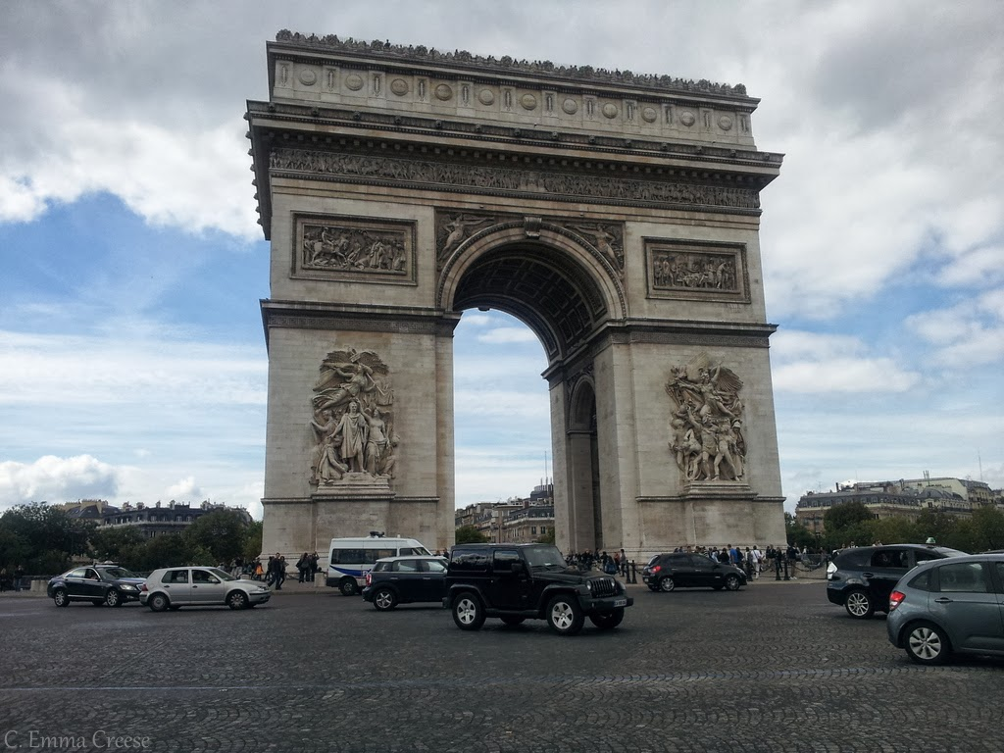
Side Trip on Discussion
Chair guides debate
Discuss
Focus on problem solving
Listen to understand
Get Facts
Respect each other
This Photo by Unknown Author i licensed under CC BY
Notes:
Adjourned meeting—p. 7-8
Quorum must vote—p. 11 Majority of those voting needed to pass. 9 of 16 present would not allow for anyone to abstain. Only 5 needed to pass if all 9 vote. If in room, you are present—don’t vote=abstain.
Chairperson is responsible for the agenda. Content, distribution, and use.

Slide 89
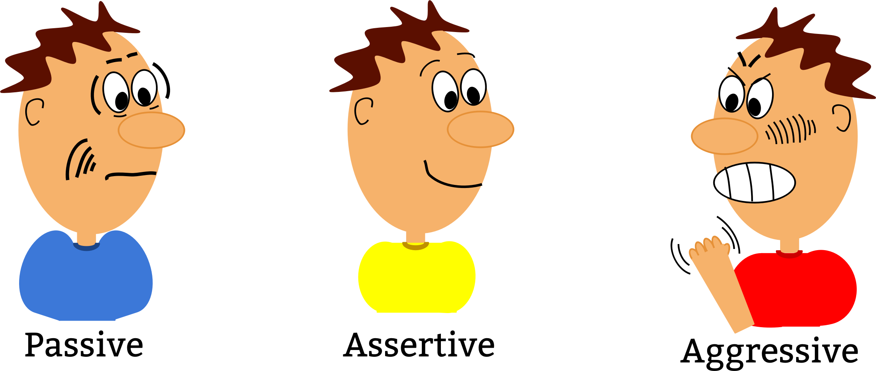
Single Person or Minority
Dominating Discussion
The Chair is responsible for administering the body’s deliberations
Advisable to seek balanced participation
Advisable to recognize members who have not yet spoken
RONR says 10-minute limit and twice to any issue – May make own rules
(RONR)
Notes:
A common concern is to deal with a person or group that wants to dominate the discussion
Remember earlier I noted that a key tenant of RONR is Fairness –
In that spirit, these RONR rules are focused on how the Chair can maintain order and provide for a full debate.

Slide 90

6. Put to Vote
Chair prompts
  “Any further discussion?”
  “Are you ready to vote?”
  “Any new points, before we vote?”
Presiding officer may not end discussion on her/his own
Presiding officer restates the question and effect of a “yes” or “no” vote
Motion to end discussion
  Needs a two-thirds vote to pass

Slide 91

End Debate – Call the Question?
How to end discussion in a meeting?
Chair can seek unanimous consent of the body
  “Board member __________ is ready to vote, is it the unanimous view of the Board to close discussion and move to a vote on the main motion.”
If any objection then to end discussion requires a motion, second and 2/3rds of the body voting to approve
This motion is not debatable

Slide 92
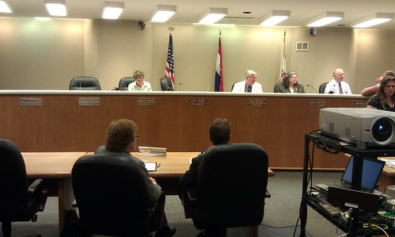
7. Members Vote
Votes can be taken in a variety of ways
  Viva-Voce (Aye/Nay)
  Show of hands
  Rising vote
  Division of the assembly or the house
  Roll-call (required if requested)
  Ballot
Ask for votes on both sides

Slide 93

Side Trip on Voting
Quorum must vote
Unless a roll call vote, there is no record of an individual abstaining from a vote
Not required to vote, Wrezeski v. Village of Madison, 558 F. Supp. 664 (W.D. Wis. 1983)
Conflicts of interest
  Remove oneself from participation or voting
  Do not have to disclose
  Treated as absent for quorum and voting purposes, Ballinger v. Door Village. 131 Wis. 2d 624 (Ct. App. 1986)
Notes:
Adjourned meeting—p. 7-8
Quorum must vote—p. 11 Majority of those voting needed to pass. 9 of 16 present would not allow for anyone to abstain. Only 5 needed to pass if all 9 vote. If in room, you are present—don’t vote=abstain.
Chairperson is responsible for the agenda. Content, distribution, and use.

Slide 94
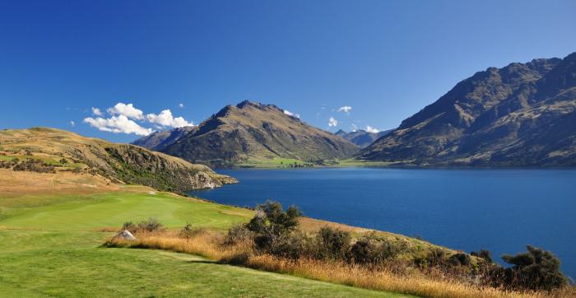
Side Trip on Voting
Therefore, the individual with a conflict of interest must remove themselves from the meeting
Suggest a roll call vote to note member removing themselves
A member can change his/her vote before final result is announced. 45 RONR 408
Where there is a tie vote, the motion fails as there is no majority in favor
Notes:
As Claire mentioned this morning, a governing body member who has a conflict of interest in a matter under discussion, should remove themselves from the meeting room and not vote on the matter

Slide 95

Side Trip on Voting
Therefore, the individual with a conflict of interest must remove themselves from the meeting
Suggest a roll call vote to note member removing themselves
A member can change his/her vote before final result is announced. 45 RONR 408
Where there is a tie vote, the motion fails as there is no majority in favor
Notes:
As Claire mentioned this morning, a governing body member who has a conflict of interest in a matter under discussion, should remove themselves from the meeting room and not vote on the matter

Slide 96
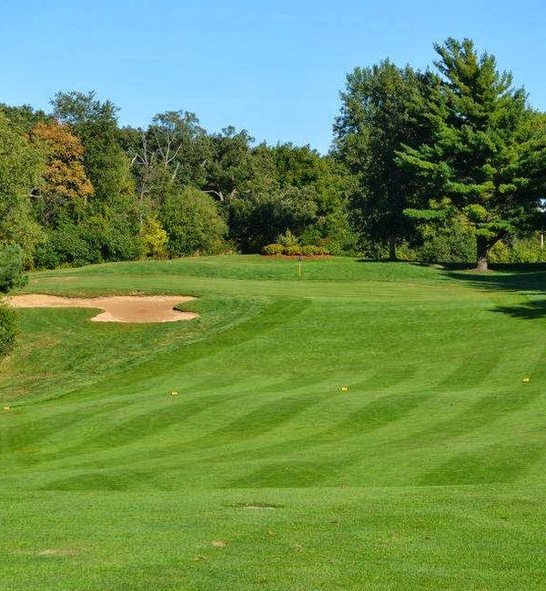
Side Trip on Voting - Abstentions
Suggest voting present, versus abstaining
Avoids potential quorum issues,
Citizens expect your representation
Notes:
As Claire mentioned this morning, a governing body member who has a conflict of interest in a matter under discussion, should remove themselves from the meeting room and not vote on the matter

Slide 97


8. Result Announced
Presiding officer announces results
  Motion carried or failed
  Number of votes on each side, if known

Slide 98
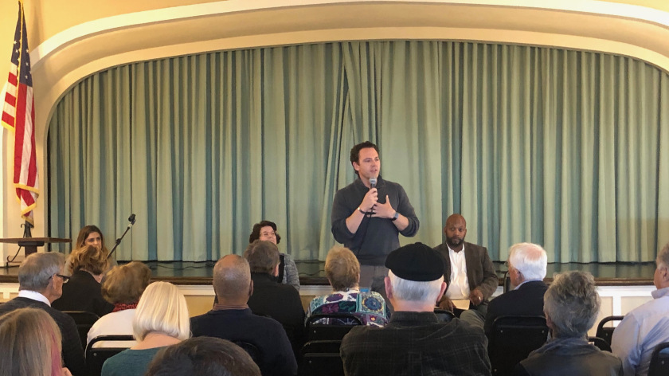
Point of Order
Pointing out a discrepancy in the application of rules of order
Needs to be made when the infraction or mistake occurs
Member states reason for the Point of Order
  I make a Point of Order that _____________
Chair – determines for or against Point of Order
(§ 89-15 C and RONR)

Slide 99
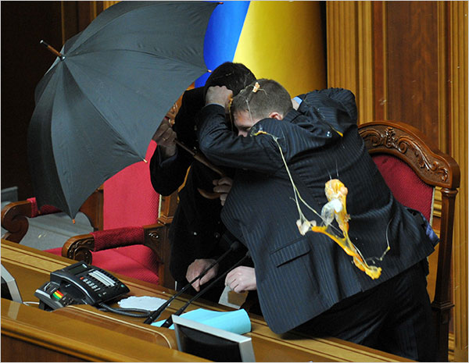
Appeals of a Chair’s Point of Order Ruling
Member – I appeal the Chair’s decision
Chair
  The decision of the Chair is appealed
  Clearly state exact question at issue and reasons for the Point of Order decision
  The vote is on: “Shall the decision of the Chair be sustained”
  Chair does not vote (§ 89-15 C)

Slide 100
Scenario #1 – Village Annual Budget Hearing
At the annual budget hearing, one citizen insists that the Annual Budget show each expenditure in its complete detail (name, cost, amount, description, etc.). As Chair, what do you do?
  Note that the budget information meets the Wisconsin Statutory requirements, or
  Thank the citizen and note the request will be considered for next year’s budget, or
  If the citizen persists, rule the citizen out of order, as the budget information meets Wisconsin statutory requirements, no changes will be considered.
  If the citizen objects, then the Board will vote to sustain the Chair, or not.

Slide 101
Scenario #2 –Village Board Meeting– Non-Agenda Item Introduced
Your Village is holding its regular Board meeting. Four members attending want to add an Agenda Item to address an item, to address a potential upcoming emergency.
As Chair, what do you do?
  Chair should rule out-of-order, as under the Open Meetings Law, only stated agenda items can be considered at a Board Meeting.
  How can the emergency be addressed? Schedule another meeting for 2:15 hours in the future and post notices accordingly.

Slide 102
Scenario #3 –Board Meeting Member Disruption
Your Board is holding a regular meeting. A Board member, who is unhappy with the Board, now wants to question and debate every Agenda Item. As Chair, what do you do?
  Chair may allow the person to do so 1-2 times, then rule the person’s future objections out of order, due to obstructing the meeting.
  If the person objects, then the Trustees can vote to sustain the Chair, or not.

Slide 103
Local Government Education Parliamentary Procedure Videos
These explanation/demonstration videos feature Dan Hill and Larry Larmer, who both have extensive experience teaching Parliamentary Procedure in Wisconsin. Each is 4-6 minutes long. Topics are:
Calling the Question
Seconding the Motion
Friendly Amendment
Withdrawing the Motion

Slide 104

Remember!

Slide 105
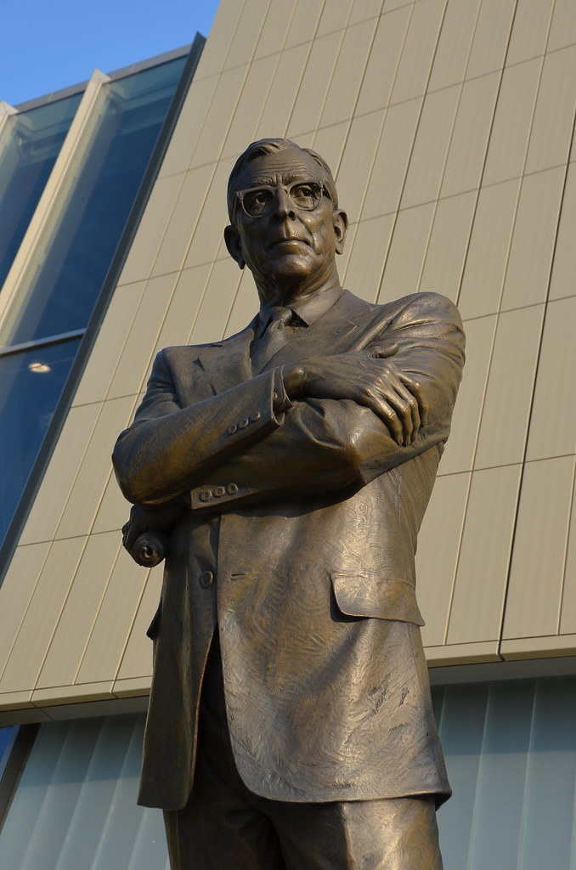
After the meeting
Success is peace of mind which is a direct result of self-satisfaction in knowing you did your best to become the best you are capable of becoming.”
John Wooden
The dash
https://lindaellis.life/the-dash-poem-author
5-19-1955 – 5-19-2032
Notes:
Coach John Wooden | Coach John Wooden in front of Pauley Pav… | Flickr

Slide 106
Wisconsin Certified Public Manager® Program
Next Hybrid Cohort –October 22, 2024
Madison, WI
Notes:
Good afternoon – My name is Daniel Foth, and I am the Director of the CPM Program and a Local Government Specialist with UW Madison-Extension Local Government Education Program.
I also want to introduce Amanda Lang, the CPM Program Assistant. Amanda is a graduate of the Wisconsin Law Enforcement Command College, the CPM program for law enforcement.
Thank you for the opportunity to introduce you to the UW Madison-Extension Local Government Education Program’s Certified Public Manager program.
The Certified Public Manager (CPM) is a United States professional designation established in 1979 to improve performance and advance best practice standards for public sector managers. Wisconsin started its CPM program in 1993. The CPM is a comprehensive management development program based on a selected set of competencies.

Slide 107









Wisconsin Certified Public Manager® Program
Personal and Organizational Integrity
Leading People
Systemic Integration
Change Management
Managing Work
Developing Self
Public Service Focus
A nationally accredited public management development program that prepares employees for the profession’s unique challenges and demands through seven core leadership competencies:
Notes:
What is CPM?
Personal and Organizational Integrity - Shape organizational ethics and create an organizational climate to strengthen relationships and reputations to build success.
Leading People - Develops leaders who understand a shared vision and the value of collaboration and communication.
Systemic Integration - Boosts productivity and improving the workflow through collaborative and creative innovations.
Change Management - Promotes and supports change by inspiring others through advocacy
Managing Work - Aligns work to organizational goals and leading others through personal responsibility and empowerment.
Developing Self - Utilizes emotional Intelligence to grow and develop as a leader and build resiliency and confidence.
Public Service Focus - Collaborates with all stakeholders to build both trust and stewardship towards the common good using accountability and transparency.

Slide 108
Who should attend?
Past participants include:
State, County, Village, Village, Town, Tribe, Special District managers, administrative and program staff
  Including administration, program, police, fire, EMS, parks, public works, IT, planners, clerks, finance, and utilities
Municipal decision-makers and program leads
Public staff, managers and supervisors ready to move their careers to the next level

Slide 109
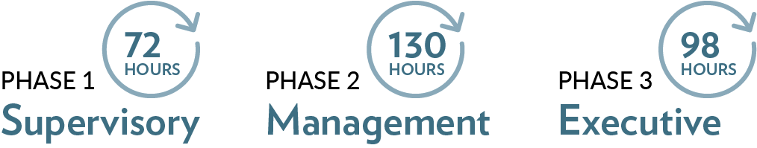
Program overview
An 18-month program (2 days per month) and learning community that will enhance your administrative, technical, analytical, management, and communication skills.
A convenient 300 total instructional hours
Hybrid Program in-person and virtual classes as designated
Notes:
CPM addresses these 7 core leadership Competencies through
Three Phases, Phase I – Supervisory; Phase II – Management and Phase III Executive as described on this slide.

Slide 110
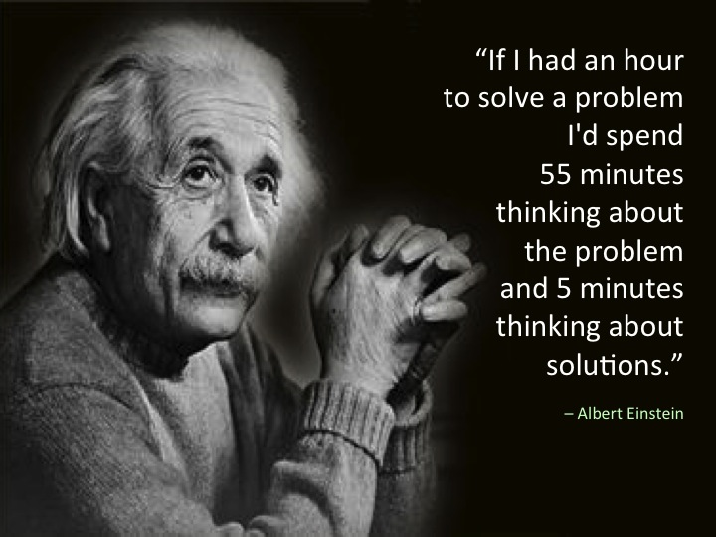
Questions?

Slide 111

Resources
Local Government Center Website - https://lgc.uwex.edu/
  Effective Meetings - https://lgc.uwex.edu/effective-meetings/
    Provides wealth of Parliamentary Procedure information, written and video format
Electronic Meetings - https://lgc.uwex.edu/update-government-meetings-during-covid-19-pandemic/
  Provides OOG, resolution templates, and webinar resources
Deliberative Governance - https://lgc.uwex.edu/deliberative-governance/
    Provides deliberative governance tools, guides and web resources
League of Wisconsin Municipalities,
  Handbook for Wisconsin Municipal Officials
  The conduct of Village Board Meetings
  The Conduct of Village Board Meetings
  Local Government Options for Conducting Meetings Remotely
Robert’s Rules of Order Newly Revised – 12th Edition 2020
Office of Open Government, https://www.doj.state.wi.us/office-open-government/office-open-government. Public Records/Open Meetings (PROM) Help Line: 608-267-2220
Daniel Foth, Local Government Center, UW Madison - Division of Extension Daniel.Foth@wisc.edu

Slide 112
Thanks!
Local Government Education
University of Wisconsin-Madison
Division of Extension
Daniel Foth
Daniel.Foth@wisc.edu
Phone: (608) 265-2852
Local Government Education
https://lgc.uwex.edu/
Notes:
Presenter
2019-06-10 19:52:43
--------------------------------------------

