Slide 1
AT&T Fiber in Town of Sevastopol, WI
April 15, 2025
Robyn Gruner, AT&T External Affairs, rt7258@att.com
Carol Anason, AT&T Access, Construction, Engineering, ca2624@att.com

Slide 2


Slide 3
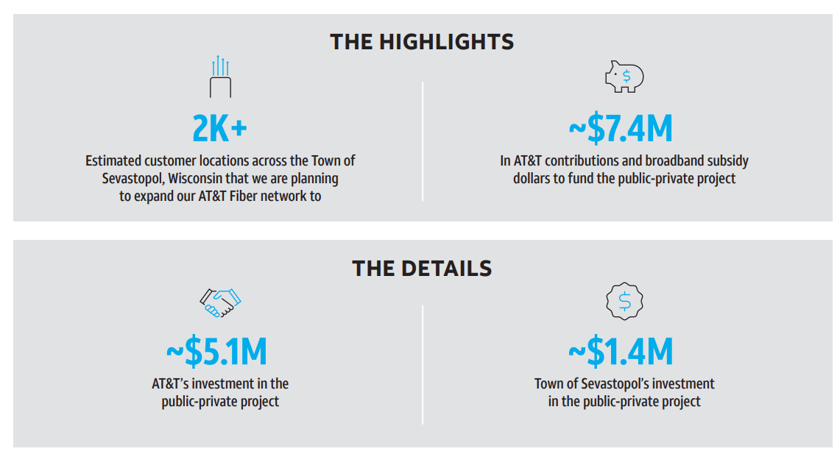

Slide 4
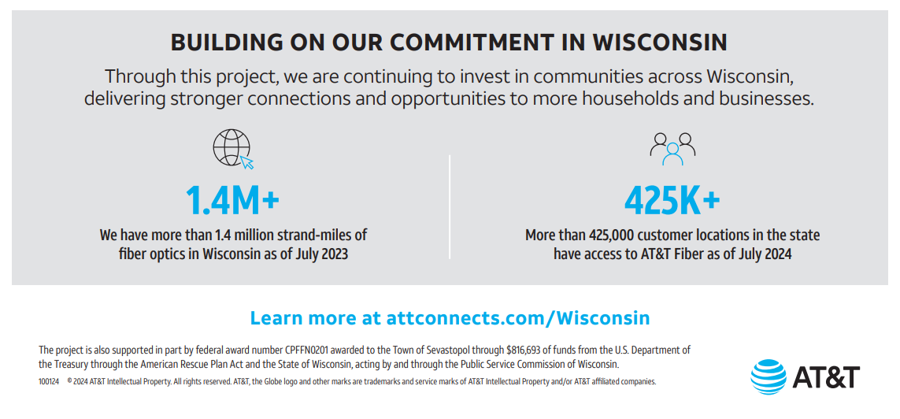

Slide 5
AT&T Fiber Project Overview & Phases
PROJECT OVERVIEW
PHASES
> 2,000 address locations
24-month build
Sept. 2024 – Oct. 2026
$7.4m Project
$5.1m AT&T investment
$1.4m Town investment
$816k WI PSC CPF grant
1. Surveying & Design – Gathering field data & preparing the design layout.
2. Project Release – Job is officially issued to construction.
3. Material & Supply Orders – Procurement of necessary materials.
4. Placement & Construction – Physical build-out begins.
5. Testing & Turn-Up – Finalizing connections and ensuring functionality, sales teams engage.

Slide 6
Project Map
**AT&T Proprietary information has been removed

Slide 7
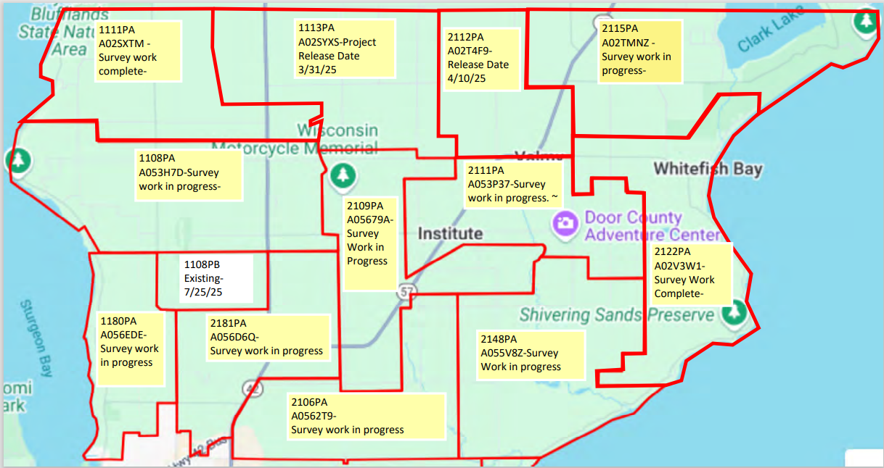
Dates noted are rough ESTIMATES &
may change based on various factors

Slide 8
Construction Process

Slide 9
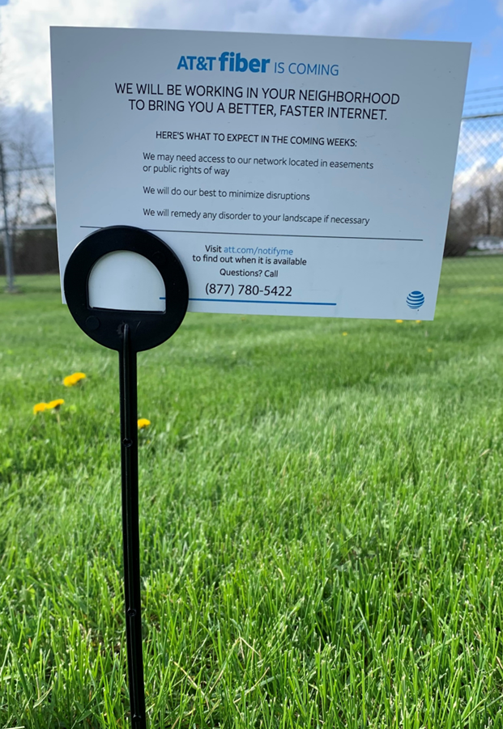
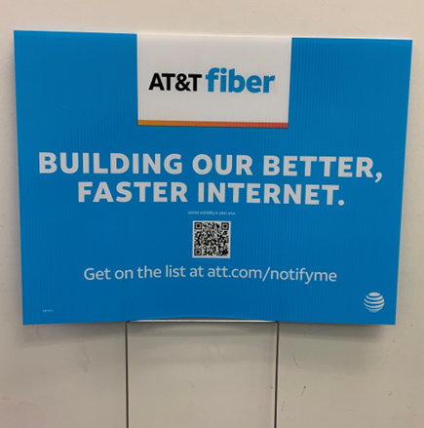
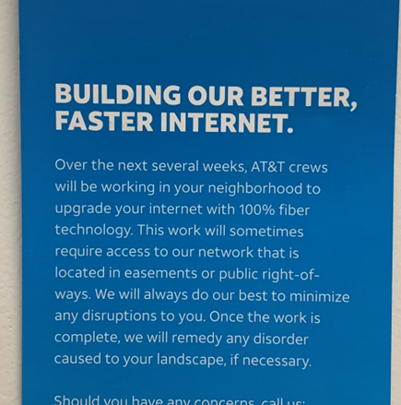
AT&T will place door hangers, neighborhood entrance signs or yard signs to communicate the fiber build that will include a brief description of what to expect along with a phone number for questions.
Margins

Slide 10
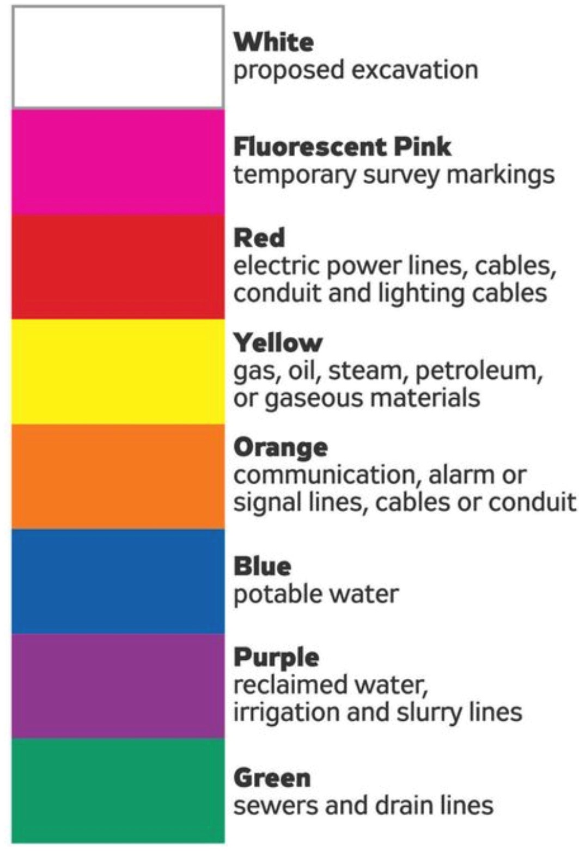
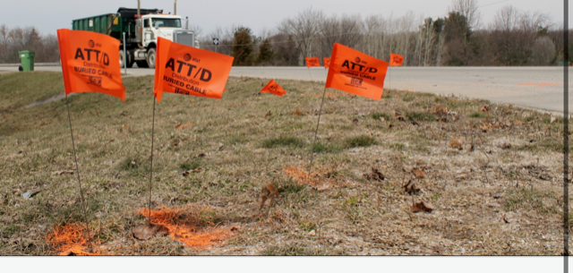
AT&T contractors will use white spray paint to show proposed placement of main connection box.
Locate company will mark utilities with paint and or flags.

Slide 11
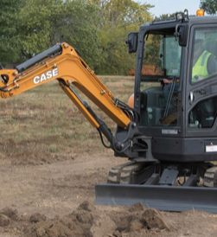
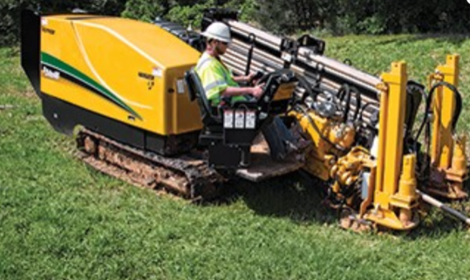
Contractors will begin placing aerial and or buried cable in the neighborhood. Different types of machinery are used including bore machines and excavators.

Slide 12
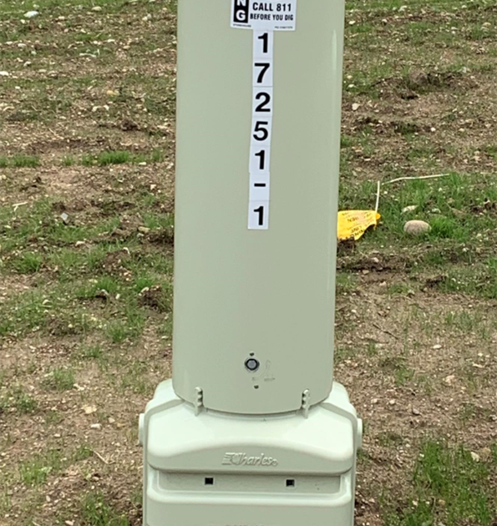
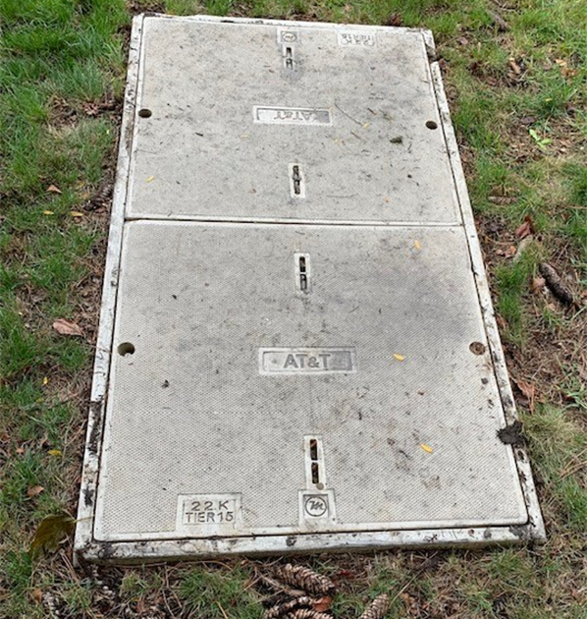
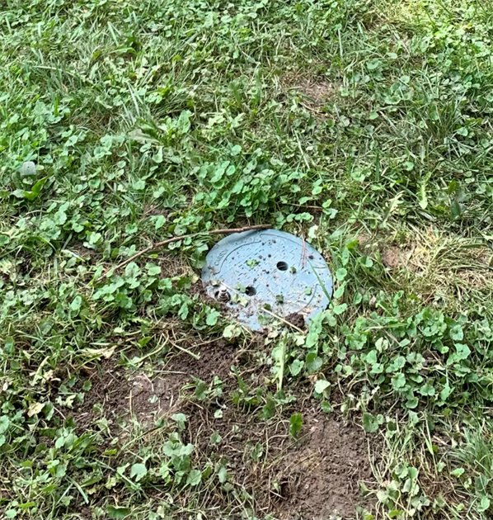
Depending on design and scope of project, contractors may place pedestals, handholes and flower-pots at pre-determined locations through out the neighborhood in easement areas.
Handhole
Pedestal
Handhole
Flower-pot

Slide 13
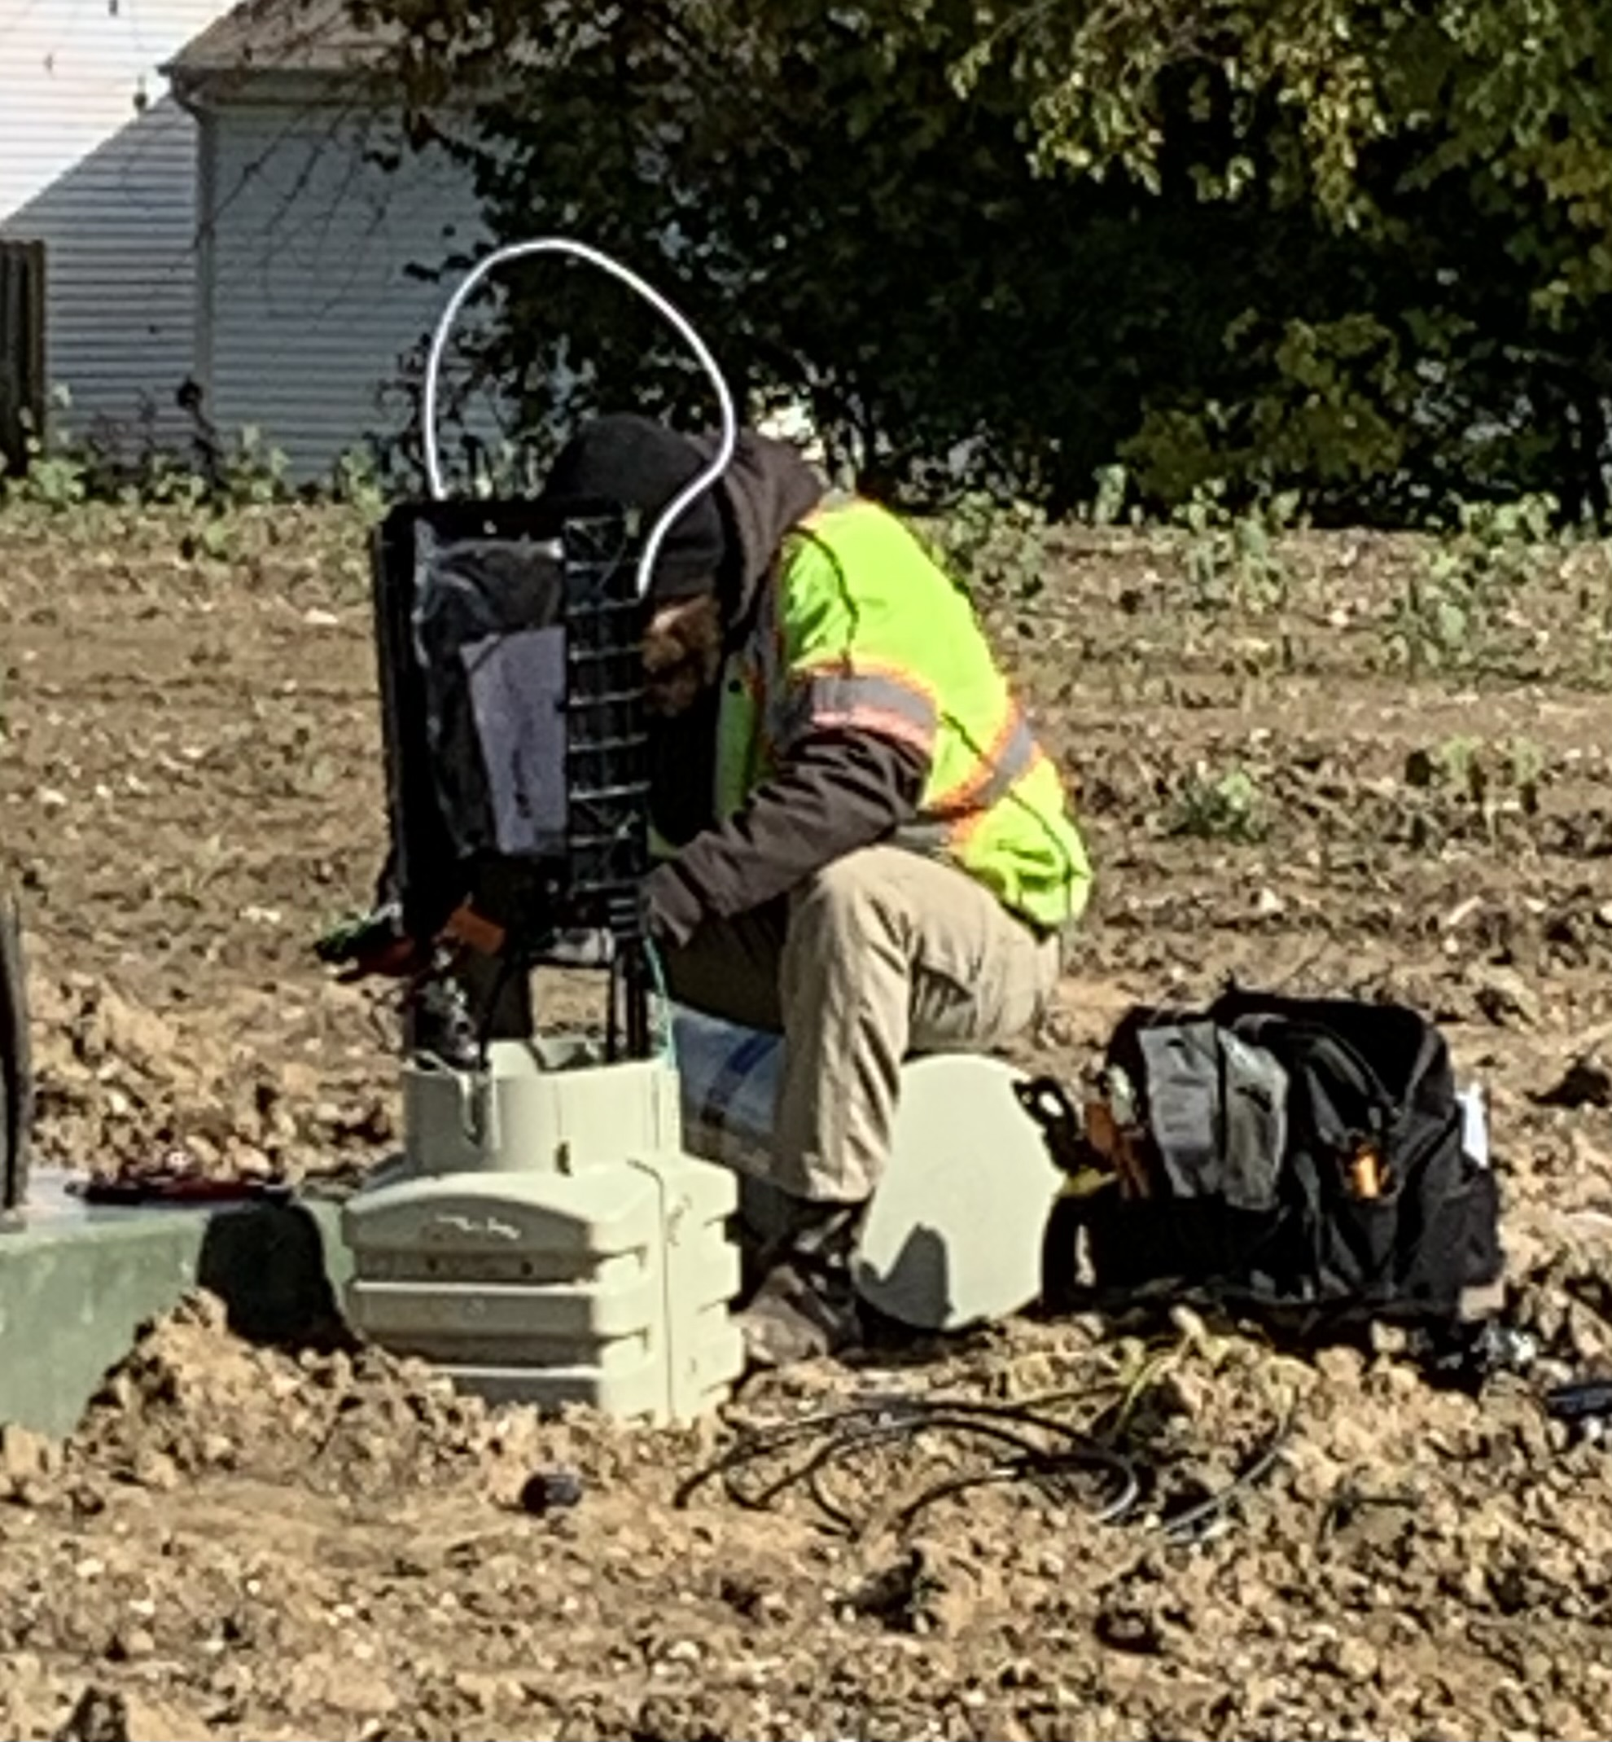
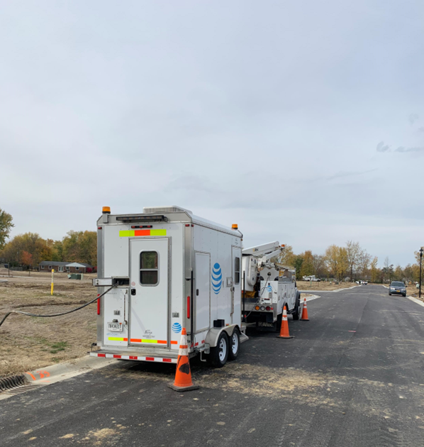
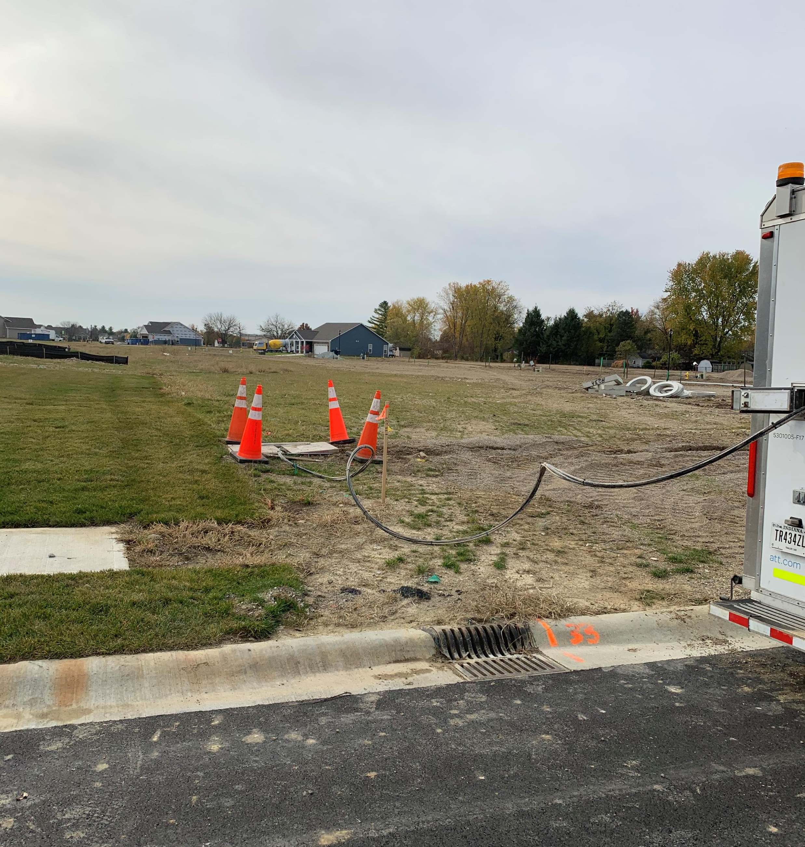
After facilities are placed AT&T Splicers will begin splicing fiber at various locations in the neighborhood
Handhole

Slide 14
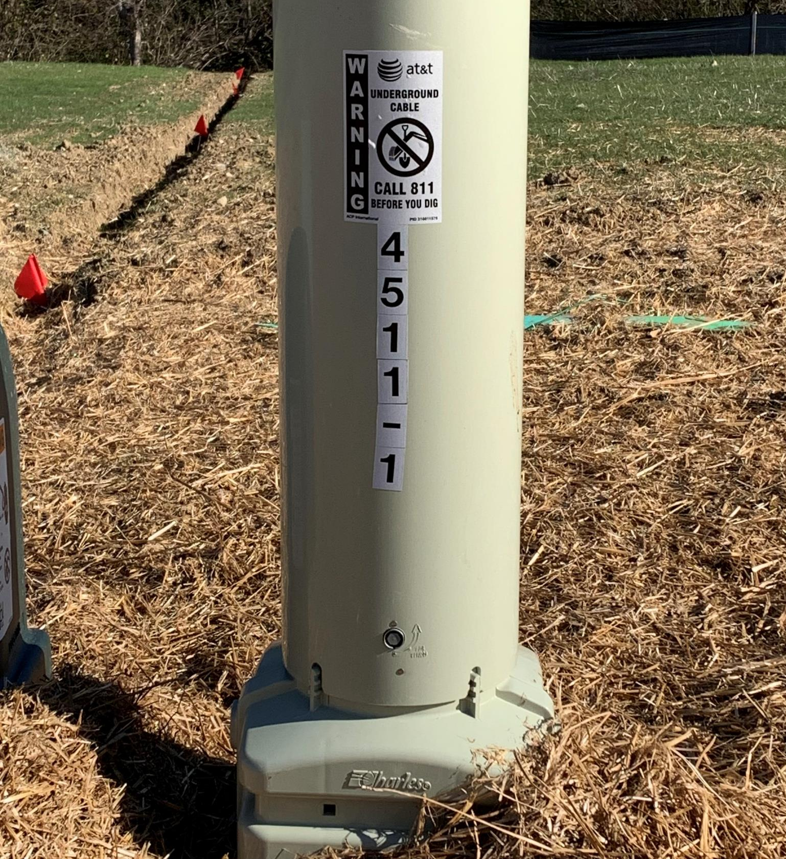
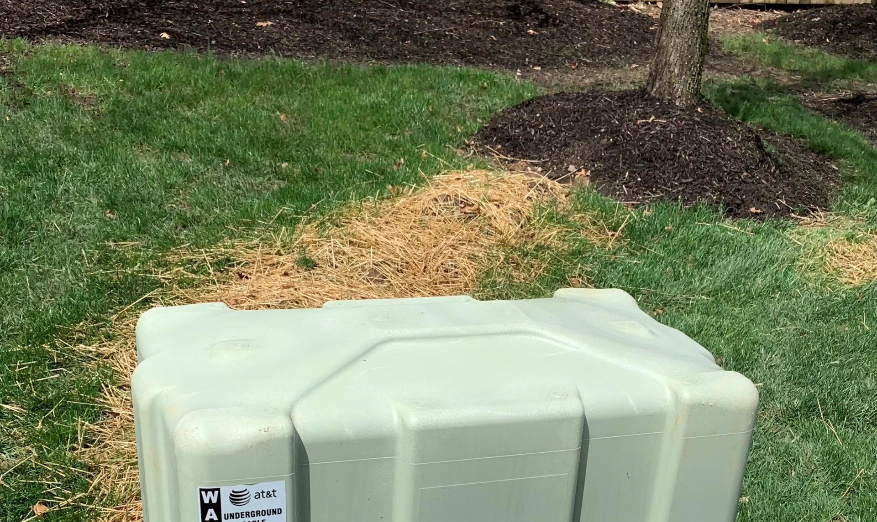
Restoration work will be completed by AT&T Contractors. We will do our best to minimize disruptions. We will remedy any disorder to your landscape, if necessary.
Handhole

Slide 15
Pricing & Fiber Speeds

Slide 16
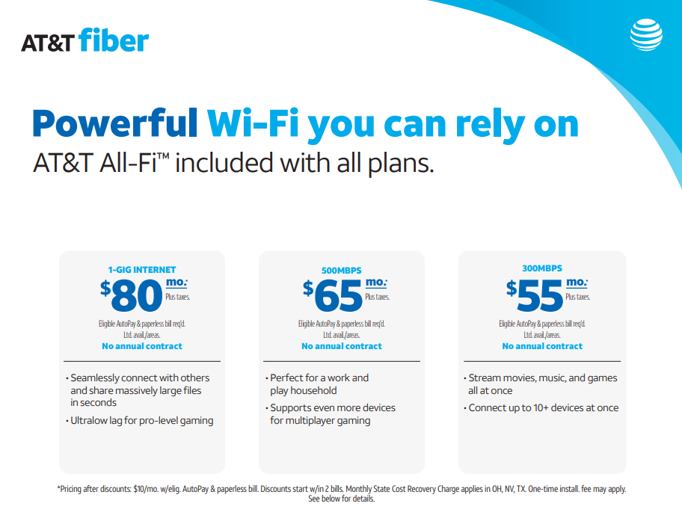
Handhole

Slide 17
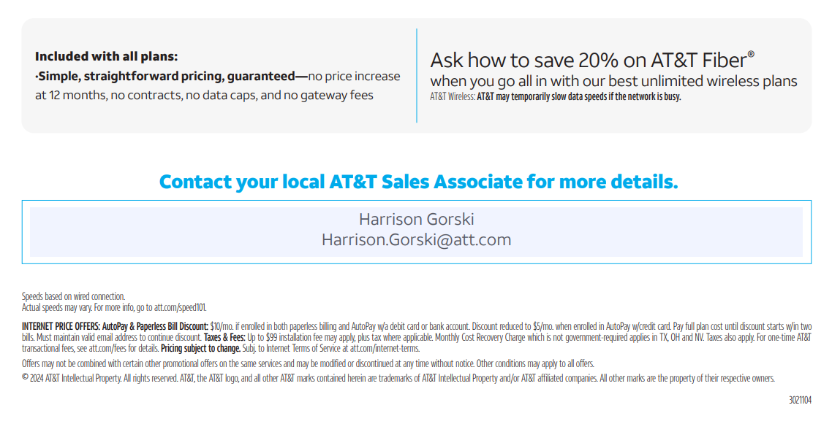

Handhole

Slide 18


Slide 19

AT&T fiber sales communication

Slide 20
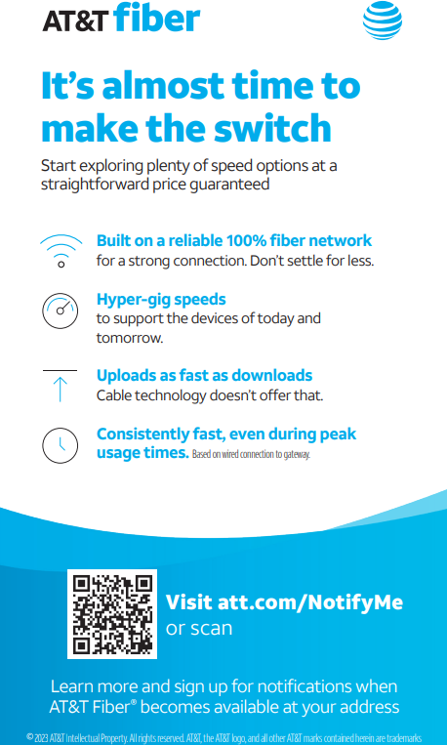
AT&T fiber sales communication

Slide 21
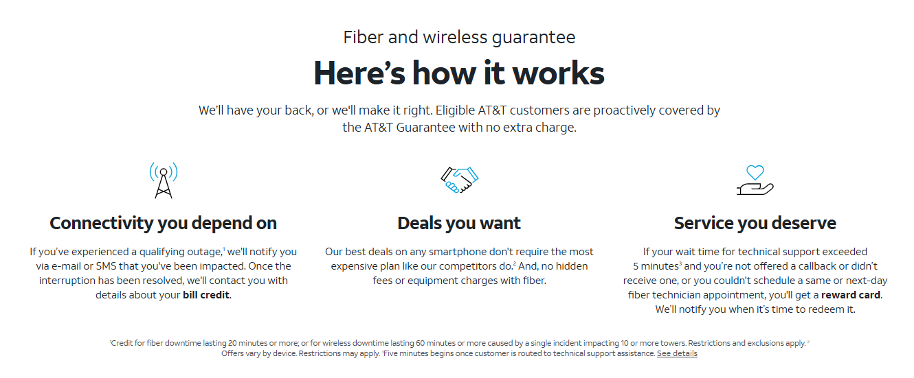
AT&T Guarantee

Slide 22
Thank You!
(Special thanks to Broadband Committee & Town Board)
Questions?
Robyn Gruner, AT&T External Affairs, rt7258@att.com
Carol Anason, AT&T Access, Construction, Engineering, ca2624@att.com
April 15, 2025

