Slide 1
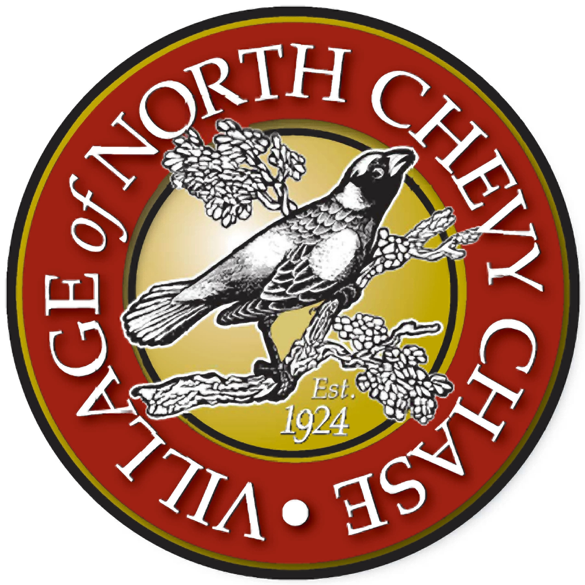
2021 Annual Report
Village of North Chevy Chase
By Adrian Andreassi, Village Council Chair

Slide 2
VILLAGE GOVERNANCE
In light of COVID-19 pandemic, established virtual Council meetings to maximize resident participation. Attendance at Council meetings has increased approximately 200% through the virtual platform.
Adopted emergency elections ordinances April 21, 2020 and February 16, 2021 to facilitate an adjusted elections timetable and absentee ballots in the event of a contested election.
May 5, 2020 -- elected Adrian Andreassi, Maury Mechanick, and Ronald Jones to 2-year terms. May 4, 2021-- elected Brian Hoffner and Chas Stuart to 2-year terms.
March 23, 2021 -- Ronald Jones resigned as Council member. April 20 meeting - Council appointed Olga Joos as a new member, to serve remainder of term until May 3, 2022.

Slide 3
FINANCIAL MANAGEMENT
Successful FY20 audit -- Village’s net position increased by $248,731 and the Village’s fund balance increased by $222,793.
Fund Balance as of March 30, 2020 totaled $1,900,200, exceeding last year’s balance ($1,737,636) by $162,564.
FY22 Budget
  Tax rate remains unchanged ($0.045/$100 assessed value for real property)
  Takes a conservative approach to revenues (i.e. assumes no revenue sharing (tax duplication) which traditionally totals $25,000 and state income tax 30% lower than projected FY21 totals)
  accounts for $284,000 in capital expenditures for trees (removals and plantings) and capital improvement projects for FY21 and FY22 identified in the 10-year capital improvement plan for streets and sidewalk repairs
Prepared bid package for audit services and selected new audit firm - LSWG

Slide 4
CAPITAL EXPENDITURES
  Removed 6 trees in Village right-of-way that were dead/dying (pin oak, 2 sugar maples, cypress, willow oak, Japanese maple) and crown cleaned/pruned 25 trees in Village right-of-way.
  Addressed additional pedestrian safety by installing:
    All-way stop at the intersection of Husted Drwy and Montgomery Ave
    “Children at Play” signs along the 3600 and 3700 block of Husted Drwy
  Worked with civil engineering firm, Clark/Azar Associates, to finalize 10-year capital improvement plan for Village streets and sidewalks. Preparation of bid package for FY21 and FY22 priority projects.

Slide 5
SERVICES
Incorporated donation opportunities for residents prior to quarterly bulk trash pick ups through Donation Nation
Finalized 3-year contract with waste management contractor (Montgomery County Sanitation & Recycling) with fixed rate of $5,800/month
Approved 22 permits this fiscal year to date
  2 additions/modifications over 250 sq ft
Updated permit application to clarify “fast-track” permits
Established opportunity for property owners to request a native tree planting anywhere suitable on their property with their agreement to assume maintenance responsibility. 61 trees to be planted this fall (deferred due to anticipated cicada infestation)
Updated Village tree survey with more detailed measurements and maintenance details and created a champion tree walk through Village - with significant support from environment committee

Slide 6
SERVICES
Worked with County’s storm water management division to reach agreement on replacement of storm drainage system at Kenilworth and Kensington Parkway to alleviate reoccurring flooding there
Worked with County on storm drain inlet repairs/upgrades identified by Clark/Azar
Requested traffic survey of Kensington Parkway by County’s Automated Traffic Enforcement Unit.
Passed resolution on “fine schedule” to ensure transparency of fines associated with Code violations
Developed process by which residents can request a new sidewalk
Updated Village email distribution list to facilitate timely messages to residents (All residents are strongly encouraged to ensure that Village management has accurate phone and email information for them).

Slide 7
INTERGOVERNMENTAL RELATIONS
Advocacy related to the I-495/I-270 “Managed Lane Study/P3 Program”
  Comments on the Draft Environmental Impact Statement
Support for Public Information Act revisions to address SHA refusal to disclose properties that received letter as part of the P3 toll lane assessment (HB 272 drafted by Delegate Al Carr)
Support for Mandatory Referral Review to ensure public works projects like the salt barn have more formal citizen input and review before approval (HB 464 drafted by Delegate Al Carr)
Advocated to SHA and District 18 representatives to address pedestrian/bicycle safety and aesthetics of fence around salt barn along Kensington Parkway
Participated in coalition to request from County Council and Planning Board that Thrive Montgomery 2050 factor in impacts from pandemic and more community involvement in its review
Participated in coalition to request “missing middle” housing in County’s draft zoning legislation be better incorporated into Thrive Montgomery 2050 process and receive more thorough analysis of affordable housing options in area

Slide 8
LOOKING AHEAD
Street and sidewalk repairs/upgrades planned for summer 2021
61 new native tree plantings throughout Village planned for this fall (likely October)
Study of vehicular speeds on Kensington Parkway forthcoming
Further research bike lane possibilities along Kensington Parkway up to Beach Dr.
Environment Committee Initiatives
  Draft list of toxic substances for possible restriction within Village
  Finalize “sustainability web page” for Village – drafted by volunteer with Sustainable Maryland program

